Slide 1


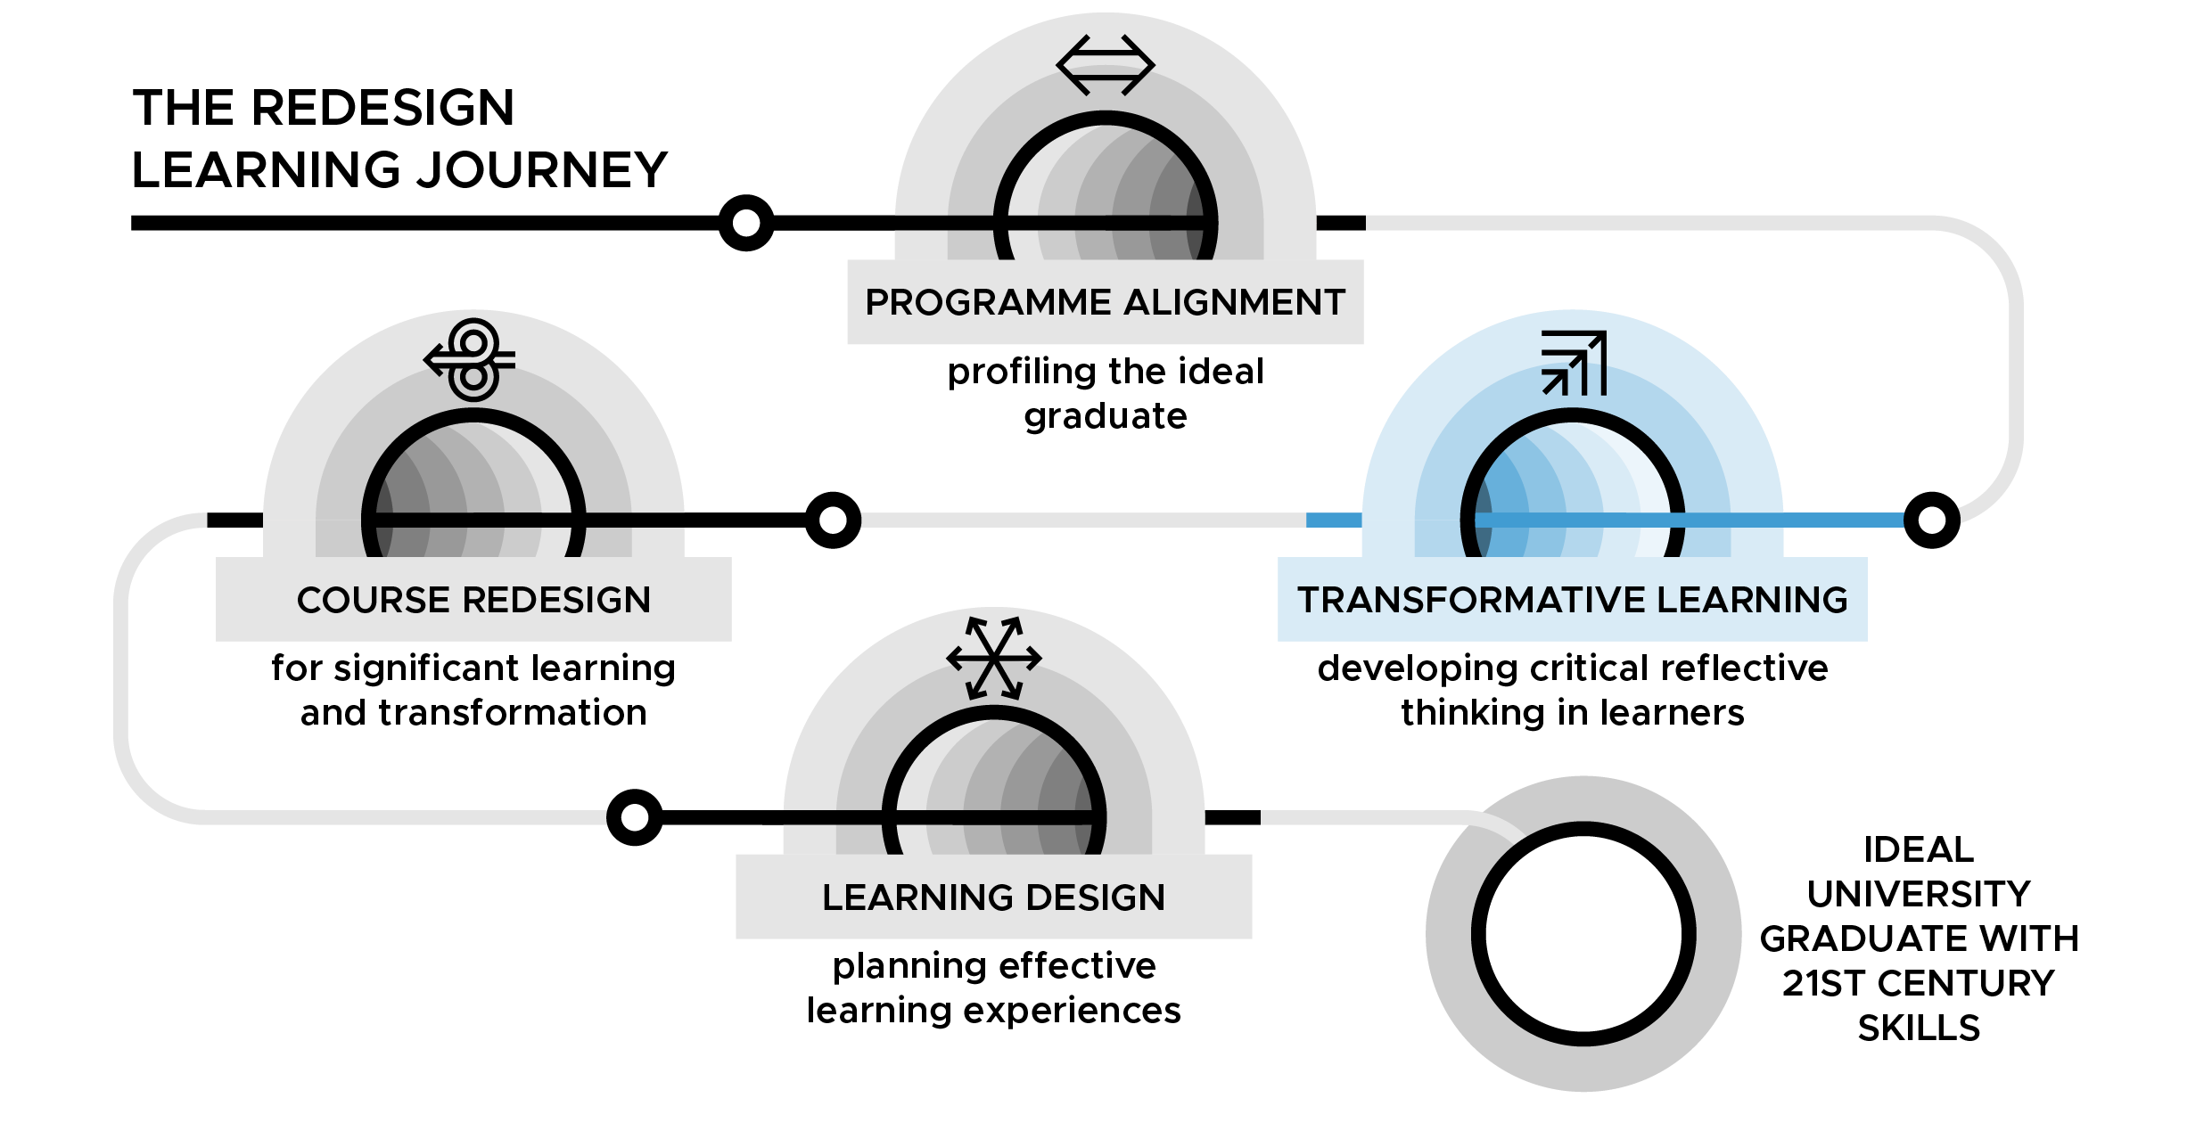

Transformative Learning - developing critical reflective thinking in learners
DAY 1

Slide 2
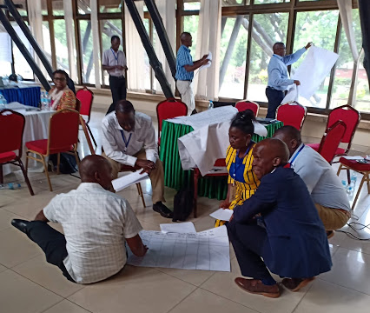
Day 1: Thinking over knowing
Mzumbe University TESCEA Transformative Learning Workshop - Morogoro, Tanzania 2019
TL Slide 1.2

Slide 3
Learning contract - ways of working
CR Slide 1.2
Arrive on time and keep to time
Participate in all sessions
Ensure that both male and female voices are heard
Cell phones on silent and calls made on breaks
Be responsible for your own learning
Respect confidentiality
Support the learning of others
Use your Participant Handbook to reflect - write down your thinking - make your thinking visible to yourself
TL Slide 1.3
Notes:
Notes

Slide 4
Learning outcomes for Day 1
By the end of Day 1, you will be able to:
Evaluate what your university promises your students and establish the existing reality
Interrogate and communicate effectively the role of Higher Education in the ‘BECOMING’ of graduates
Articulate your personal teaching and learning philosophy
TL Slide 1.4

Slide 5
Gender-responsive pedagogy
TL Slide 1.5

Slide 6
Generating ideas
Question 1: How can you ensure that only male students are going to learn/benefit from your class or learning session?
Question 2: How can you ensure that only female students are going to learn/benefit from your class or learning session?
TL Slide 1.6

Slide 7
Generating ideas
Reverse your answers to the first question to look at:
What can you do to ensure that both male and female students will learn/benefit from your class or learning session?
TL Slide 1.7

Slide 8
Individual reflection
Have you picked up any useful idea(s) that you could use, in your own teaching or facilitation practice, to enhance the learning experience of male and female students in your learning sessions?
What are these?
TL Slide 1.8

Slide 9
Topsy Turvy (also known as reverse brainstorming)
5 steps to reverse brainstorming:
Identify the problem/challenge
Reverse the problem/challenge
Brainstorm the reverse problem to generate reverse solution ideas
Reverse the ideas for the reverse problem into solution ideas for the original problem
Evaluate the solution ideas
https://www.mindtools.com/pages/article/newCT_96.htm
TL Slide 1.9

Slide 10
Individual reflection
Have you picked up any useful idea(s) that you could use, in your own teaching or facilitation practice, to enhance the learning experience of male and female students in your learning sessions?
What are these?
TL Slide 1.10

Slide 11
Overall objectives of session:
The Promise vs The Reality
To clearly articulate:
what is promised to students by the university
the actual reality based on feedback from stakeholders
how the promise and the reality compare
how participants propose to handle the identified issues with regards to the established existing divide, if it is determined to exist
TL Slide 1.11

Slide 12
Group discussion and reflection (5 mins)
Are you as a university currently delivering on your promise to your students?
Are your graduates currently becoming what you had envisioned?
What % of your graduates presently are becoming what was envisioned by the university?
TL Slide 1.12

Slide 13
Group task: the Promise vs the Reality
What are the identified gaps?
What needs to change?
What needs to be enhanced?
What needs to be done away with?
TL Slide 1.13

Slide 14
Group discussion: comparative analysis
What needs to be different or could be different?
What is the gap | change | elimination | emphasis identified?
How can they be addressed – what action needs to be taken?
Who are the stakeholders involved in addressing them?
Who in your team will drive this action?
What is the timeline for the stipulated action?
TL Slide 1.14

Slide 15
  Reflection on the Promise vs the Reality session (7 mins)
  How did working through this session make you feel? (share your actual feelings for e.g. sad, mad, intrigued, challenged etc.)
  Why do you think you felt this way?
  What has this session inspired you to do next?
TL Slide 1.15

Slide 16
Share your responses with your group (20 mins)
Discuss individual key points, e.g. what similarities/ differences did you find?
Organise key points under 3 main insights on flip chart paper and draw lines between key ideas to establish what connections exist between them.
Debate the reasons for your choices as you follow this mapping process.
Discuss what stands out for your group as being the most significant concept, having considered the reflective questions. What are your reasons?
TL Slide 1.16

Slide 17
Educating a New Generation of African Leaders - a TedTalk
TL Slide 1.17

Slide 18
Group discussion and reflection (10 mins)
What does it mean when a course has value?
What strategies are there in the facilitation of learning?
What are we actually referring to when speaking of a learning environment?
TL Slide 1.18

Slide 19
Group comparative analysis between course with impact and course without impact (25 mins)
What was the value of each of these courses?
How was each course facilitated?
What was the environment within which the course was taught?
What was the attitude of the lecturer?
  towards the content/course
  towards the learners
TL Slide 1.19
Notes:
Notes

Slide 20
Individual reflection (5 mins)
Gender responsive pedagogy
The Promise vs The Reality
The Banking Concept
The Mandate of the Elite
Characteristics of a Great Learning Experience
Where do you fall currently on the continuum below?
Are you facilitating learning for impact?
|----------------------------------------------------------------------------------|
Banking Approach Problem-Posing Approach
TL Slide 1.20

Slide 21
Individual task: your personal teaching & learning philosophy (15 mins)
What is the value you intend to create through your facilitation?
What approach will you use to facilitate learning?
What kind of learning environment do you intend to create to allow for a great learning experience?
What is your attitude towards the content you are facilitate learning about?
What will your attitude be towards your students?
TL Slide 1.21

Slide 22
End of Day 1 reflection
Note to workshop facilitator: if you using an online form then insert the link here.
TL Slide 1.22

Slide 23








TESCEA was part of the UKAID-funded SPHEIR programme
The SPHEIR (Strategic Partnerships for Higher Education Innovation and Reform) programme supported higher education transformation in focus countries in Sub-Saharan Africa, Asia and the Middle East.
www.spheir.org.uk

