Slide 1


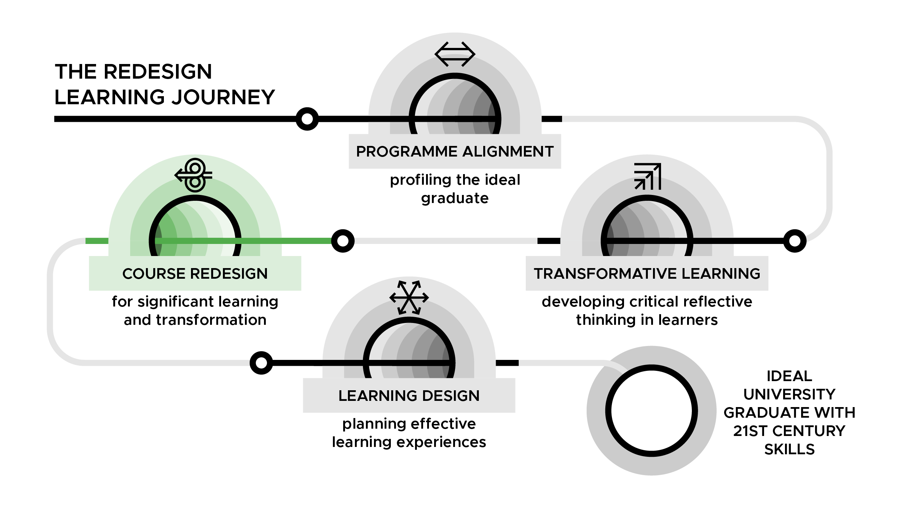

Course Redesign for Significant Learning and Transformation Workshop
DAY 4

Slide 2
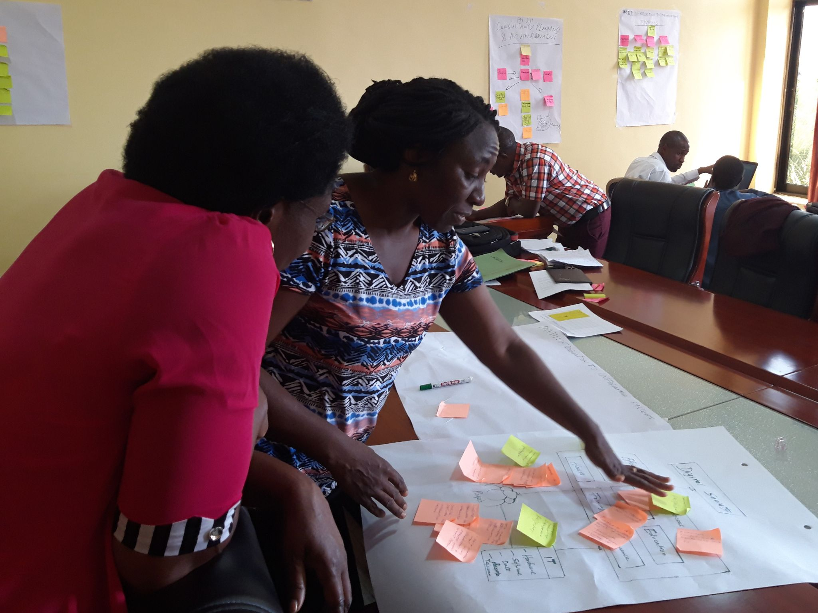
Day 4: Teaching and learning strategies
University of Dodoma Course Redesign Workshop, September 2019
CR Slide 4.2

Slide 3
Results from formative evaluation (Day 3)
CR Slide 1.2
CR Slide 4.3

Slide 4
Gender is… interaction and space
CR Slide 4.4

Slide 5
Individual reflection
How have male/female students behaved differently in your class or learning session?
What was your role as a facilitator of learning in relation to these interactions?
CR Slide 4.5

Slide 6
Discussion of Reading
What ideas, terms and concepts stood out for you in the reading? (refer to your ‘Notes on assigned reading form’ and/or read the summary of key points)
What do you understand by the term thinking? (write one sentence per sticky note)
CR Slide 4.6

Slide 7
Discussion of Reading
What do you mean when you say ‘I want my students to think’?
What kinds of thinking do you value in your course?
What teaching and learning strategies can promote the kinds of thinking that you value in your course?
CR Slide 4.7

Slide 8
A weaving together of ideas across the four readings
Look at your Notes on assigned reading forms that you have completed for the four assigned readings.
What ideas can you connect or weave together on the basis of the ‘understanding map’ in today’s assigned reading?
Use an image or metaphor to illustrate this weaving together of ideas.
CR Slide 4.8

Slide 9
The Understanding Map
Observe closely and describing what is there
Building explanations and interpretations
Reasoning with evidence
Making connections
Considering different viewpoints and perspectives
Capturing the heart and forming conclusions
Wondering and asking questions
Uncovering complexity and going below the surface of things
Source: Ritchhart, R., Church, M. & Morrison, K., (2011). “Chapter 1 – Unpacking Thinking.” Making Thinking Visible: How to promote engagement, understanding, and independence for all learners. Jossey- Bass. page 10-15.
CR Slide 4.9

Slide 10
TSL (Soft) Skills Matrix
Determine the teaching and learning strategies that will enable students to practise and strengthen the skills/capabilities/ dispositions outlined under each of the key skills headings assigned to your group
Be ready to explain the reasons for your choices
CR Slide 4.10

Slide 11
1 | Building a knowledge (FK) Oral and written communication (HD) | Negotiation & managing conflict (HD) Creativity and innovation (A)
2 | Reflective thinking (I) Leadership (HD) | Dealing with an uncertain future (LHL) Making sound arguments and decisions (A)
3 | Analysing claims/ arguments of others (A) Networking (I) | Interpersonal skills (HD) Self-direction (LHL)
4 | Commitment to positive social change at community level (C) Teamwork (HD) | Applying information to personal, social and/or work life (I) Evaluating and interpreting information (A)
5 | Selecting appropriate information (A) Interconnected thinking (I) | Self-management (HD) Social awareness (C)
CR Slide 4.11

Slide 12
Demonstration: Moving from Learning Outcomes to Teaching and Learning Strategies
Note to workshop facilitator: insert the link to your selected Day 4 video demonstrating the process of moving from course learning outcomes to teaching and learning strategies:
Video 4.1a – www.inasp.info/CR41a
Irine Akite of Gulu University, Uganda
Video 4.1b – www.inasp.info/CR41b
Tupokigwe Isagah of Mzumbe University, Tanzania
CR Slide 4.12

Slide 13
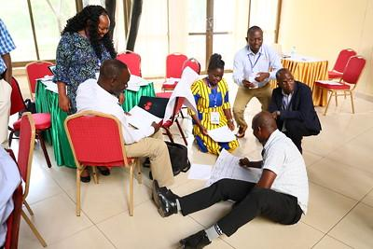
Next step
Proceed to your breakout groups to start selecting teaching and learning strategies which align with your course learning outcomes
Mzumbe University Course Redesign Workshop, January 2019
CR Slide 4.13

Slide 14
Most effective teaching and learning strategies to meet learning outcomes
Which of the teaching and learning strategies and activities that you use in your current courses, do you find the most effective in meeting learning outcomes and why?
CR Slide 4.14

Slide 15
Conversational Framework and the six types of learning
(www.inasp.info/CR42)
The Conversational Framework
CR Slide 4.15

Slide 16
The six types of learning
Which types of learning require the least active engagement of students in the learning process and which require the most?
CR Slide 4.16

Slide 17
The six types of learning
Learning Type | Level of active engagement of students
Acquisition (read, watch, listen) | LOW HIGH
Inquiry (investigation)
Discussion
Practice
Collaboration
Production
CR Slide 4.17

Slide 18
Teaching and learning strategies and the six types of learning
Under which of the six types of learning do the strategies in the ‘Final list of teaching and learning strategies’ belong?
Come up with at least one strategy for each of the six types of learning.
Include any new strategies that you can think of.
CR Slide 4.18

Slide 19
Padlet with example teaching and learning activities/strategies
Link:
Padlet: teaching and learning activities / strategies
CR Slide 4.19

Slide 20
Ensuring the best and most effective learning experience for your students
Are you combining a rich mix of learning activities which balance all six learning types to make for the best possible learning experience for your students?
What strategies/ activities do you need to change or add, to ensure the student learning experience is as effective as possible?
CR Slide 4.20

Slide 21
Reflection
How has my learning increased because of the readings, what new observations did I make?
During the facilitation of the previous session, can I identify and describe some of the stages the session went through and how they align with the Transformative Learning Cycle?
CR Slide 4.21

Slide 22
Phases of the Transformative
Learning Cycle
Concrete experience - an activity that gets learners to surface their misconceptions about a concept.
Reflective observation - an activity that gets learners to observe their thinking about a concept.
Abstract conceptualisation - this is the point where the facts that underpin a concept are introduced.
Active experimentation - an activity that gets the learners to test drive their new found knowledge.
CR Slide 4.22

Slide 23
Redesign a single learning session
Develop a learning session that incorporates:
A lot of sensory input from the students
Reflective questions to surface common assumptions & misconceptions students have about a concept
Factual data that will expose the theories that underpin the field of study
An activity to help formalise new ideas formed due to student interaction with the presented facts
Another experience that will help students to test out their new found knowledge
CR Slide 4.23

Slide 24
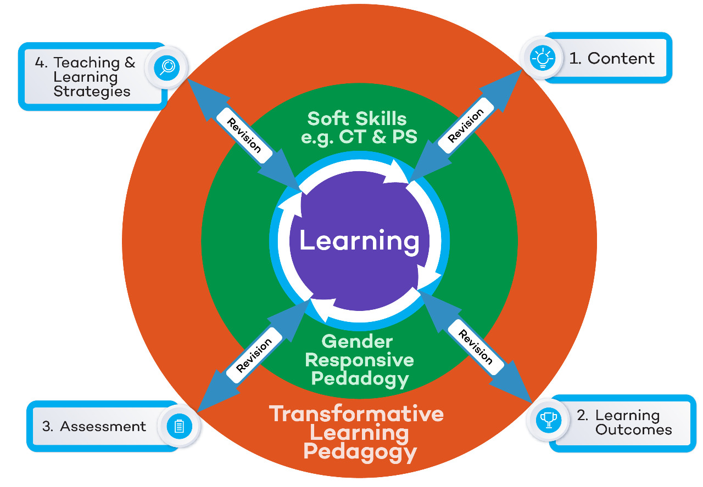
Formative Evaluation
CR Slide 4.24

Slide 25








TESCEA was part of the UKAID-funded SPHEIR programme
The SPHEIR (Strategic Partnerships for Higher Education Innovation and Reform) programme supported higher education transformation in focus countries in Sub-Saharan Africa, Asia and the Middle East.
www.spheir.org.uk

