Slide 1


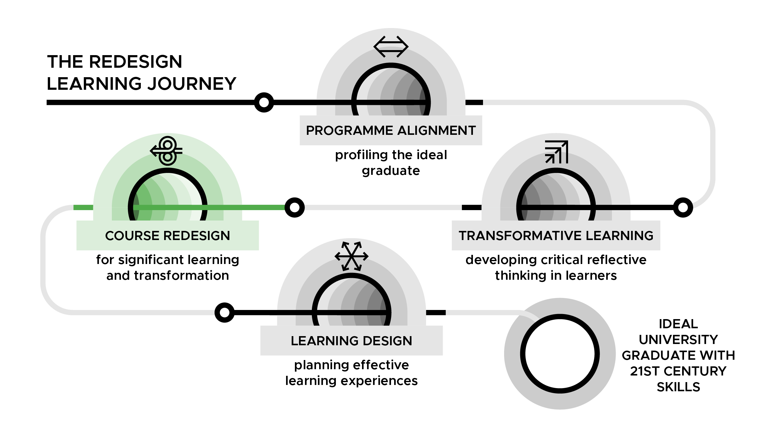

Course Redesign for Significant Learning and Transformation Workshop
DAY 2

Slide 2
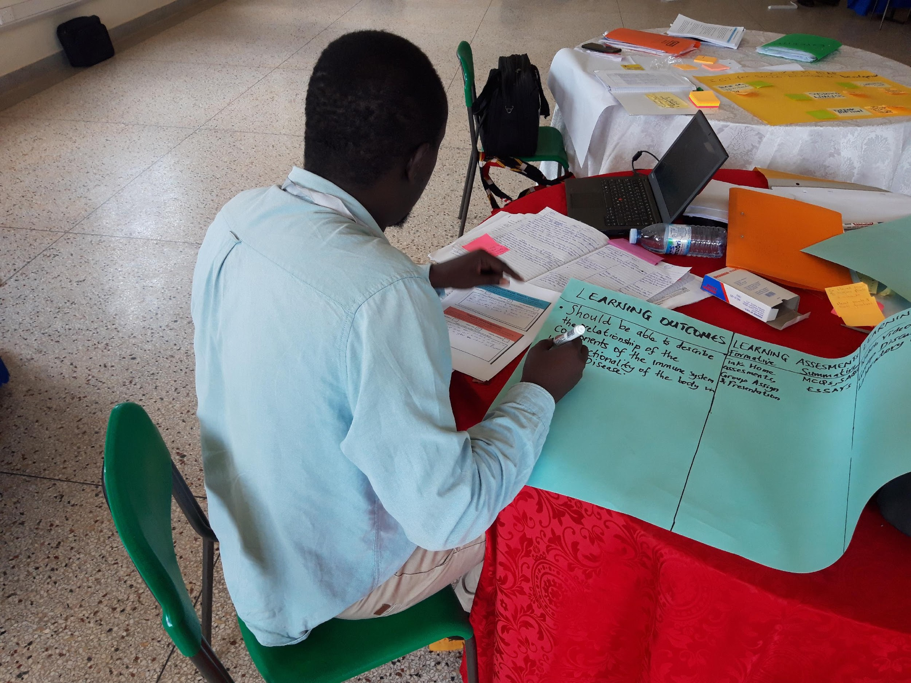
Day 2: Learning Outcomes
Gulu University Course Redesign workshop, August 2019
CR Slide 2.2

Slide 3
Results from formative evaluation (Day 1)
CR Slide 1.2
CR Slide 2.3
Notes:
Notes

Slide 4
Results from formative evaluation (Day 1)
CR Slide 1.2
CR Slide 2.4
Notes:
Notes

Slide 5
Results from formative evaluation (Day 1)
CR Slide 1.2
CR Slide 2.5
Notes:
Notes

Slide 6
Gender is… stereotypes and (conscious/unconscious) bias
CR Slide 2.6

Slide 7
Gender audit of industry
In programme groups:
What is the ratio of men/women who work in the profession?
In what roles do they work? Are their roles different, or the same?
How many women can you name in the profession in top positions?
What jobs do male/female graduates from your programme go on to do? Are their roles different, or the same?
What are the dropout rates for male/female graduates in your programme? Are they different, or the same?
CR Slide 2.7

Slide 8
Gender audit of industry
[Programme]
Male/female dropout ratios:
Male/female graduate unemployment ratios:
CR Slide 2.8

Slide 9
Unconscious bias
CR Slide 2.9

Slide 10
Unconscious bias (or implicit bias) is…
a bias that happens automatically
something we are unaware of
triggered by our brain making quick judgments and assessments of people and situations
influenced by our background, cultural environment and personal experiences.
https://royalsociety.org/topics-policy/publications/2015/unconscious-bias/
CR Slide 2.10

Slide 11
Studies from the US have found
Blonde women’s salaries were 7% higher than brunettes or redheads.
“Mature-faced” people had a distinct career advantage over “baby-faced” people.
Both male and female scientists were more likely to hire men, rank them higher in competency than women, and pay them $4,000 more per year than women.
58% of Fortune 500 CEOs are almost six feet tall, whereas only 14.5% of the overall male population are that size.
CR Slide 2.11

Slide 12
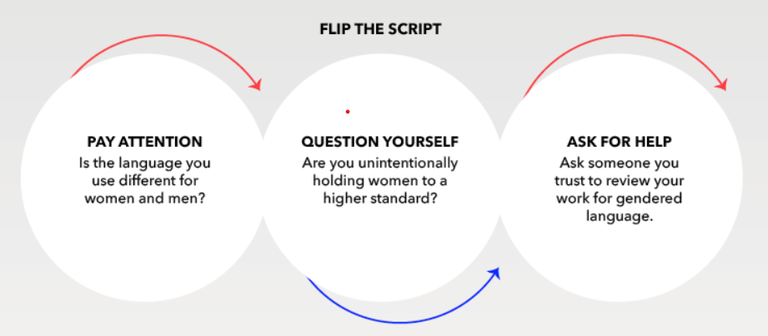
Image by “Catalyst, Flip the Script: Women in the Workplace (May 7, 2018)”
CR Slide 2.12

Slide 13
Understanding unconscious bias
Royal Society animation and briefing on unconscious bias:
https://royalsociety.org/topics-policy/publications/2015/unconscious-bias/
CR Slide 2.13

Slide 14
Reflection in pairs
Do you think that the industry audit results have been influenced by stereotypes and/or bias?
If so, how?
CR Slide 2.14

Slide 15
Individual reflection
What do the audit results mean for your course in terms of how you will prepare your students for the industry they will encounter after graduation?
Think about:
What gender issues will your students, as future professionals, encounter during the course of their professional work?
Will they be sensitive to the different needs women & men might have as their customers/patients/pupils or users of products?
How can you make them more aware of gender stereotypes they might encounter in the field you are teaching in?
CR Slide 2.15

Slide 16
Reading Discussion
The 4Cs -
Connections: What connections do you draw between the text and your own life or your learning in general?
Challenge: What ideas, positions, or assumptions do you want to challenge or argue within the text?
Concepts: What key concepts or ideas do you think are important and worth holding onto from the text?
Changes: What changes in attitudes, thinking, or action are suggested by the text, either for you or others?
CR Slide 2.16

Slide 17
Follow up questions on discussions
How did the structure of the activity help you to develop a deeper understanding of the text?
How easy was it, for you to find points for any of the 4C’s? Why?
What came up in the discussion that surprised you?
CR Slide 2.17

Slide 18
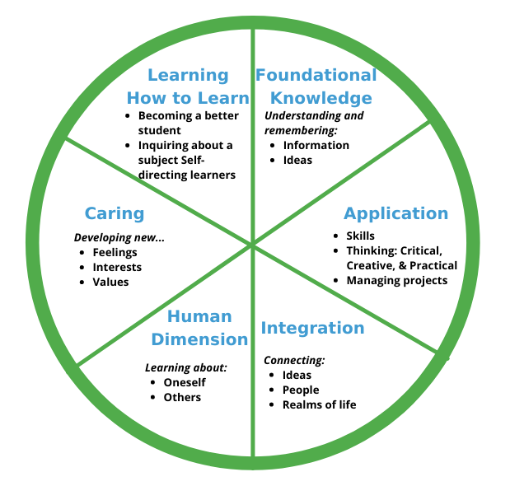
Taxonomy of Significant Learning
CR Slide 2.18

Slide 19
Significant Learning
Definition:
Learning that actually has an impact on how students live their lives after the course is over and even after university (Fink, 2013)
CR Slide 2.19

Slide 20
Background to the development of the TSL (soft) skills matrix
Video on the background of the TSL (soft) skills matrix:
www.inasp.info/CR22
CR Slide 2.20

Slide 21
TSL (Soft) Skills Matrix
Kinds of learning
Headline soft skills
Application
Integration
Human dimension
Caring
Learning how to Learn
Leadership
Commitment to positive change at community level
Critical thinking
Interpersonal skills
Self-direction
Creative thinking
Teamwork
Problem solving
Interconnected thinking
Reflective thinking
CR Slide 2.21

Slide 22
Soft Skills Learning Outcomes
Utilise locally available feedstuffs to feed dairy animals for optimum production.
Critically evaluate security flaws in web applications.
Communicate effectively the existence of archive services to the public.
Value the role of gender in ensuring food and nutrition security.
Analyse the current national and international economic issues to project future trends.
CR Slide 2.22

Slide 23
Demonstration: Moving from Concept mapping to Learning Outcomes
Note to workshop facilitator: select one of the following two links for your selected Day 2 video on demonstrating the process of developing a concept map:
Video 2.1a – www.inasp.info/CR21a
Irine Akite of Gulu University, Uganda
Video 2.1b – www.inasp.info/CR21b
Tupokigwe Isagah of Mzumbe University, Tanzania
CR Slide 2.23

Slide 24
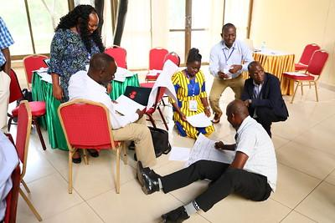
Next step
Proceed to your breakout groups to start crafting your course learning outcomes
Mzumbe University Course Redesign Workshop, January 2019
CR Slide 2.24

Slide 25
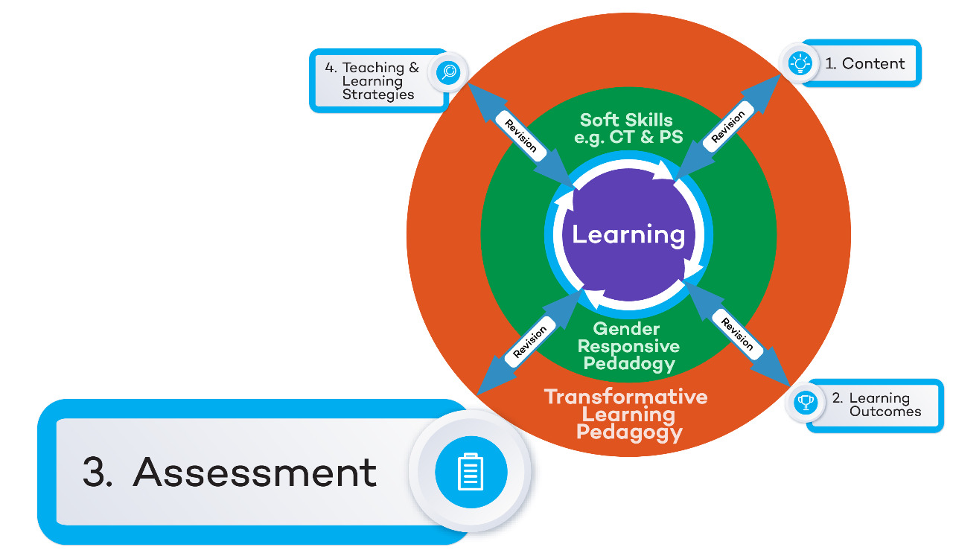
Course Redesign Workshop: Concept Map
CR Slide 2.25

Slide 26
Workshop Content
Content | How do you understand the subject matter and the skills required for your course?
Learning Outcomes | What will students know, value, do as a result of participating in your course?
Assessment | How will you and the students be able to assess progress towards the learning outcomes?
T&L Strategies | What kind of practice and feedback will help students reach the learning outcomes?
Soft Skills | What soft/transferable skills will students have developed as a result of participating in your course?
Gender responsiveness | What gender knowledge and skills will students have developed as a result of participating in your course?
Transformative Learning | How will your course create an environment that promotes critical reflective thinking so that students become the experts they need to be, to transform themselves & their world?
CR Slide 2.26

Slide 27
Assessment Activity
Thoughts on these four quotations?
What we assess, signals what we want students to learn (Fenwick & Parsons, 2000)
Assessment defines the actual curriculum from the students' point of view (Ramsden, 2003)
Assessment is the most significant prompt for learning (Boud, 1995)
Students can, with difficulty, escape from the effects of poor teaching; they cannot (by definition) escape the effects of poor assessment (Boud, 1995)
CR Slide 2.27
Notes:
Fenwick, T.J., & Parsons, J. (2000). The Art of Evaluation: A Handbook for Educators and Trainers. Toronto: Thompson Educational Publishing, Inc.
Ramsden, P. (2003). Learning to teach in higher education (2nd Ed). New York: Routledge.
Boud, D. (1995). Assessment and Learning, Contradiction and Complementary. In Assessment for Learning in Higher Education edited by Peter Knight.

Slide 28
Formative Assessment
What is formative assessment?
Why formative assessment?
When does it happen?
Where does it happen?
CR Slide 2.28

Slide 29
Formative Assessment
What is formative assessment?
Assessment that transforms learning / improves students’ learning
Why formative assessment?
To adjust teaching / inform one’s learning sessions
When does it happen?
All the time
Where does it happen?
In ordinary learning conditions
CR Slide 2.29

Slide 30
Formative Assessment: Assessment AS Learning
For improvement & growth (learning and teaching)
Feedback
Conducted during learning process
May be graded or not graded
CR Slide 2.30

Slide 31
Summative Assessment: Assessment OF Learning
For decision making
A judgment or verdict
End of learning process - or is it?
Usually graded
CR Slide 2.31

Slide 32
Learning or Testing?
There is need for Assessment ‘as’ Learning and ‘for’ learning (Formative Assessment) not just Assessment ‘of’ Learning (Summative Assessment) which is about testing/judging.
CR Slide 2.32

Slide 33
Formative Evaluation
What is the most perplexing aspect (muddiest point) about developing meaningful and practical assessments for your courses?
CR Slide 2.33

Slide 34








TESCEA was part of the UKAID-funded SPHEIR programme
The SPHEIR (Strategic Partnerships for Higher Education Innovation and Reform) programme supported higher education transformation in focus countries in Sub-Saharan Africa, Asia and the Middle East.
www.spheir.org.uk

