Slide 1


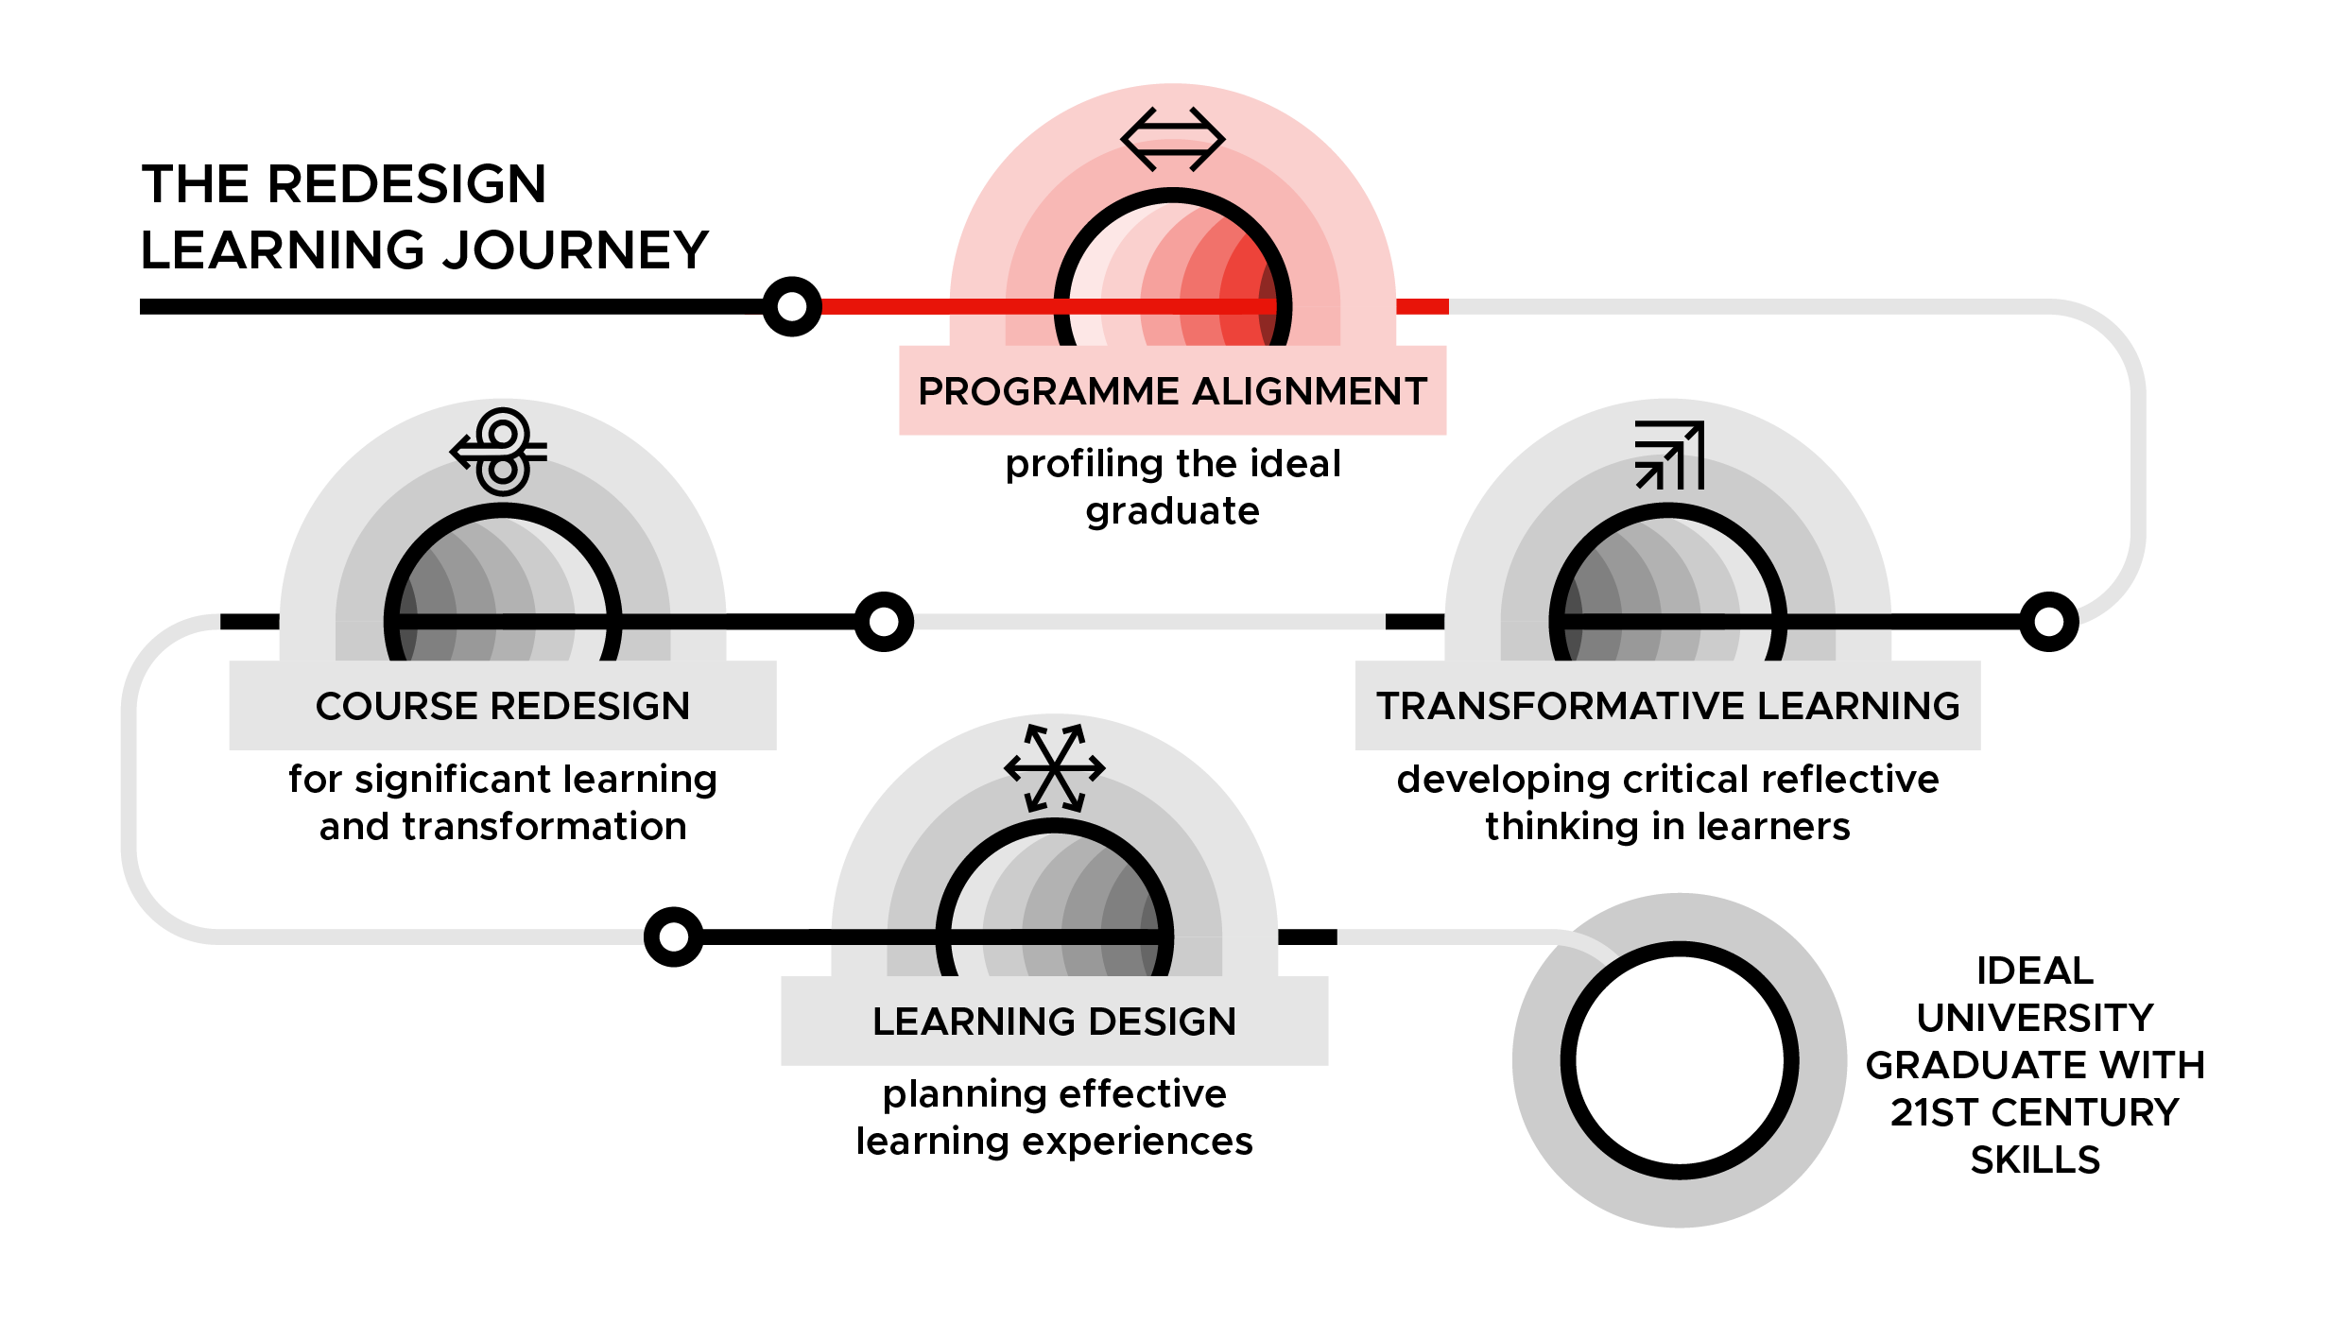

Programme Alignment – Profiling the ideal graduate
DAY 1

Slide 2
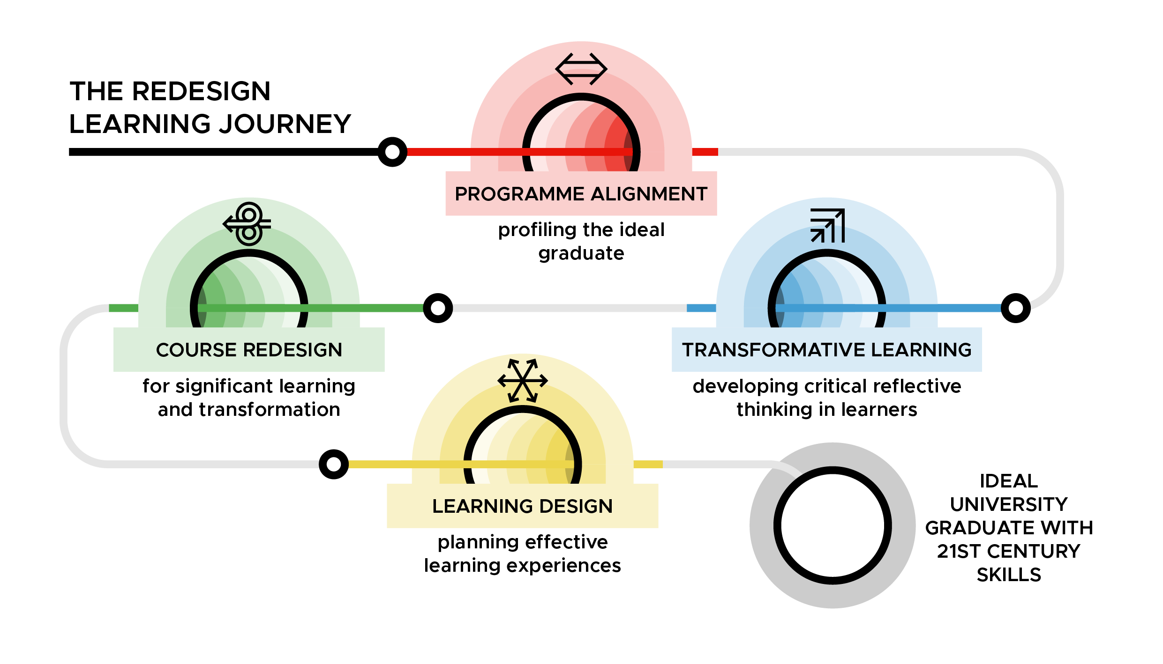
Transforming Higher Education for Social Change learning journey
PA Slide 1.2

Slide 3
Programme Alignment
PA Slide 1.3

Slide 4
Day 1: Evaluating Our Performance as an Institution
Reflecting on
  External stakeholder feedback
  Student and lecturer feedback
  How the university promotes itself
  Gender responsiveness of the university
  Performance against QA standards
PA Slide 1.4

Slide 5
Learning outcomes Day 1
By the end of Day 1, you will be able to
Determine what skills, competencies and habits of mind your graduates will need when leaving the university.
Evaluate to what extent the current performance of the university matches the aspirations of its vision and mission.
Compare experiences of female and male students at the university.
PA Slide 1.5

Slide 6
External stakeholder feedback
  Presented by:
PA Slide 1.6

Slide 7
External stakeholder feedback: Pre-presentation reflections
What do you think external stakeholders will see as:
Key strengths of current university graduates?
Key gaps in skills, knowledge and competencies of current university graduates?
PA Slide 1.7

Slide 8
Group reflections on external stakeholder feedback
What were the key strengths and weaknesses of graduates noted by external stakeholders?
Were there any differences noted among female and male graduates by the external stakeholders? If so, what were these?
How do the key strengths and weaknesses noted by the external stakeholders compare with your reflections prior to the presentation?
What does the feedback from the external stakeholders mean in terms of the skills, competencies and habits of mind your graduates will need when leaving your university?
PA Slide 1.8

Slide 9
Internal stakeholder feedback
  Presented by:
PA Slide 1.9

Slide 10
Internal stakeholder feedback: Pre-presentation reflections
Based on feedback you have received from current and former students:
What elements of your course/s are working well in terms of equipping your students for the world of work?
What elements of your course/s could be improved in terms of equipping your students for the world of work?
PA Slide 1.10

Slide 11
Group reflections on internal stakeholder feedback
What is working well and what is not working well in terms of preparing both female and male students for the world of work?
Are there any differences in feedback from female and male stakeholders/students? If so, what are these?
What skills, competencies and habits of mind are your university currently imparting to students that should be maintained?
What skills, competencies and habits of mind that students require are currently not being imparted by your university?
PA Slide 1.11

Slide 12
How the university promotes itself
Individual reflection
If you were a prospective student, what would you expect from the university based on the promotional materials displayed around the room?
How do these expectations fit with the vision and mission of the university?
PA Slide 1.12

Slide 13
How the university promotes itself
In groups:
Question 1: If you were a prospective female student, what would you expect from the university based on the promotional materials shared?
Question 2: If you were a prospective male student, what would you expect from the university based on the promotional materials shared?
PA Slide 1.13

Slide 14
How the university promotes itself - reflections
Thinking back to the start of the session:
Question 1: Did your expectations change when you considered the promotional materials as a prospective female student? If so, how?
Question 2: Did your expectations change when you considered the promotional materials as a prospective male student? If so, how?
PA Slide 1.14

Slide 15
Gender responsiveness of the university
Individual reflection:
Do you think that there are any differences in how your female and male students experience their time at your university?
If so, what do you think these might be?
PA Slide 1.15

Slide 16
Student feedback
In groups:
Was there anything in the student feedback that aligned with or differed from your individual reflections? If so, what?
Was there anything in the student feedback that surprised you? If so, what?
PA Slide 1.16

Slide 17
Admission, retention and graduation rates
In groups:
Are there any gender disparities between the admission, retention and graduation rates (both at the university and programme level)?
If so, what do you think might be the cause of these?
Is there anything in the student feedback that you think might help to explain these disparities?
PA Slide 1.17

Slide 18
University vision and mission
Looking at your reflections from this session, does the university deliver on what it promises in its vision and mission to both female and male students?
PA Slide 1.18

Slide 19
Performance against QA standards
  Presented by:
PA Slide 1.19

Slide 20
Performance against QA standards
How do you think the university’s current performance measures up to national, regional, and/or international standards?
PA Slide 1.20

Slide 21
Group reflections on performance against QA standards
Does the information presented match your own previous reflection? If so, in what way? If not, how does it differ?
Does the university’s current performance match the aspirations in its vision and mission? If so, in what way? If not, why not?
PA Slide 1.21

Slide 22
Day 1 reflections
Think back on the presentations and discussions from today. What stood out to you? What is something you did not know before?
PA Slide 1.22

Slide 23
Day 1 formative evaluation
What did you like most about today?
What is something from today that could be improved?
How are you going to use what you learned today in your professional life?
PA Slide 1.23

Slide 24








TESCEA was part of the UKAID-funded SPHEIR programme
The SPHEIR (Strategic Partnerships for Higher Education Innovation and Reform) programme supported higher education transformation in focus countries in Sub-Saharan Africa, Asia and the Middle East.
www.spheir.org.uk

