Slide 1


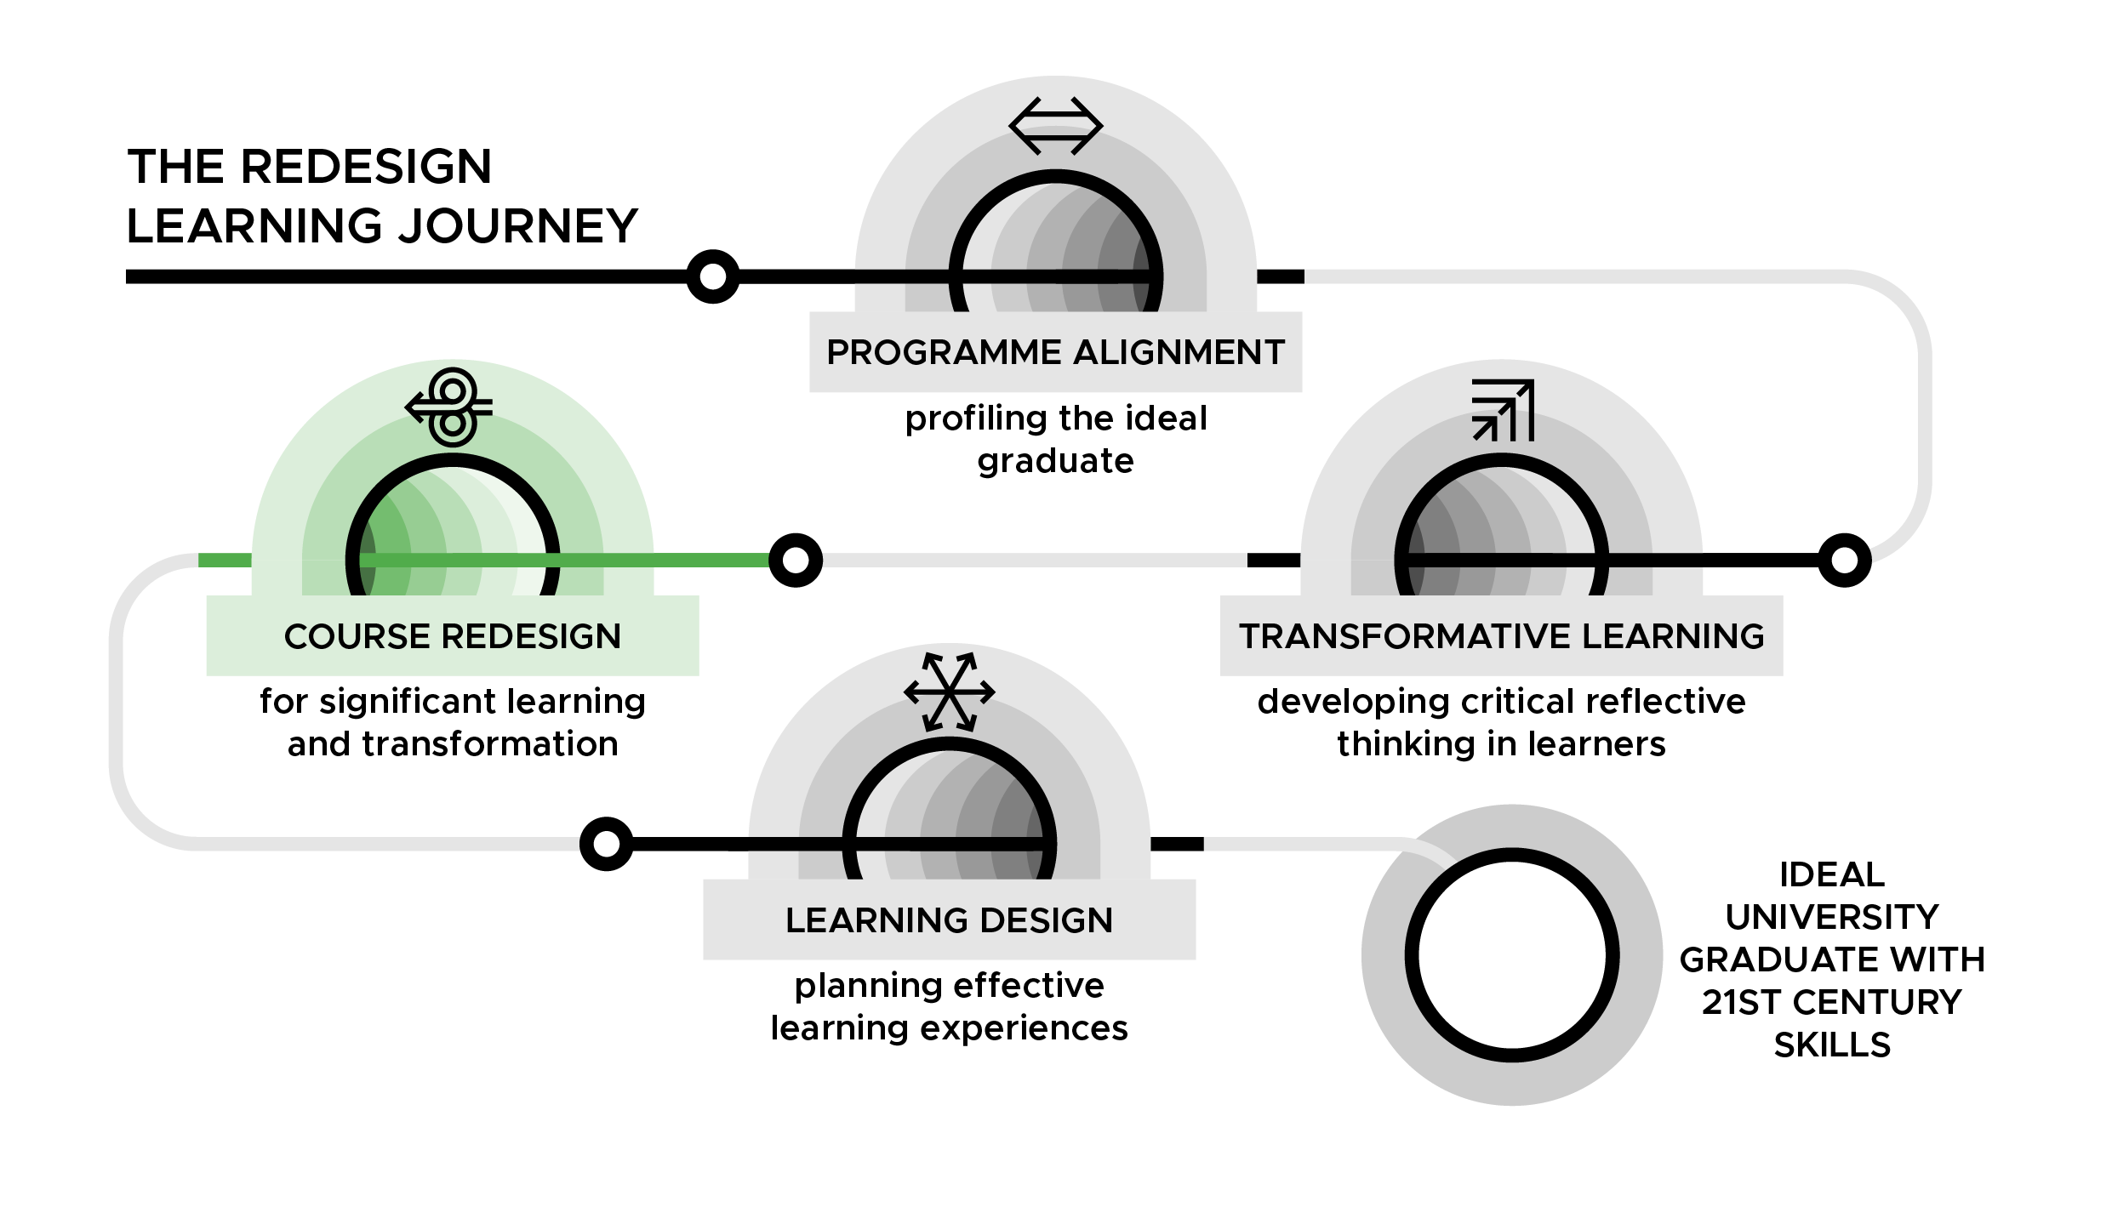

Course Redesign for Significant Learning and Transformation Workshop
DAY 3

Slide 2
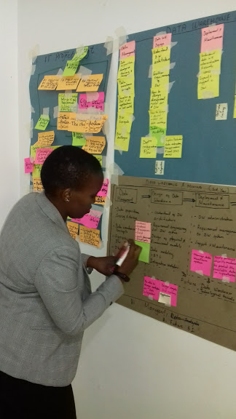
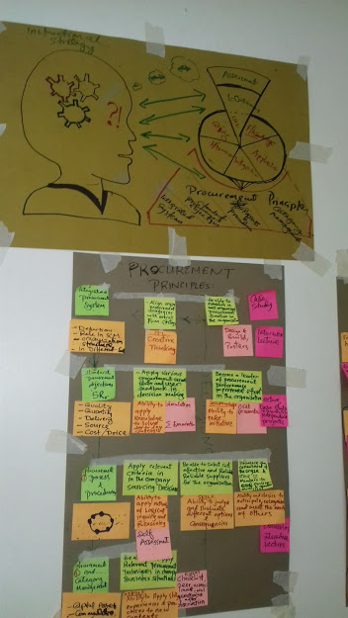
Day 3: Assessment
Mzumbe University Course Redesign Workshop, October 2019
CR Slide 3.2

Slide 3
Formative Assessment Question
(Day 2)
CR Slide 1.2
What is the most perplexing aspect (muddiest point) about developing meaningful and practical assessments for your courses?
CR Slide 3.3
Notes:
Notes

Slide 4
Gender is… internalised bias
CR Slide 3.4

Slide 5
Instructions for the roleplays
CR Slide 1.2
Two rounds of roleplay with three different roles
Roles rotate so each group member plays two of the three roles once
The roles are:
Facilitator of learning (participant giving feedback) – 2 minutes speaking time during roleplay
Student (participant receiving feedback - keeping silent) - 1 minute at end of roleplay to share reflections: “how did you feel receiving the feedback?”
Observer (silent during roleplay) – 1 minute at end of roleplay to share reflections: “What did the facilitator of learning do well and what could they improve on?”
CR Slide 3.5
Notes:
Notes

Slide 6
Group reflection
CR Slide 1.2
What are the implications of these role plays for the workplace?
If a female student gets the top grade in all her written work but is silent in class, how might this translate to how she operates in the workplace?
If a male student is overly confident, but does not do enough work to fulfill his potential, how might this translate to how he operates in the workplace?
How might internalised bias have affected the students in the roleplay scenarios?
CR Slide 3.6
Notes:
Notes

Slide 7
Discussion of Reading
Group 1: rules 1, 3, 6, 10 and 13
Group 2: rules 2, 5, 7 and 14
Group 3: rules 4, 8, 9,11 and 12
CR Slide 3.7

Slide 8
Educative Assessment
Assessment itself educates
Design assessment tasks that go beyond simply telling us whether students “got it” or not; rather the assessment tasks should help students learn more
CR Slide 3.8

Slide 9
Major Components of Educative Assessment
Forward-looking
assessment task
Criteria and
standards
Self-assessment
Feedback
CR Slide 3.9

Slide 10
Assessment Tasks
Forward-Looking
Backward-Looking
You look ahead to what you expect or want students to be able to do in the future as a result of having learned about x, y, z.
Learning-centred approach
You look back on what you have taught and you assess the students on the same.
Content-centred approach.
CR Slide 3.10

Slide 11
Forward-Looking Assessment Tasks
…in the sense that you look forward beyond the end of the course by creating a realistic life or work situation (including any gender aspects).
…asking students to use what they’ve learned and/or will learn to address questions or make decisions related to that situation.
CR Slide 3.11

Slide 12
Forward-Looking Assessment Tasks
What am I trying to prepare students to do?
What is it I am trying to determine that students are ready or not ready to do?
CR Slide 3.12

Slide 13
Rubrics (Criteria/Standards)
Rubrics are assessment tools that are used when it is not practical to draft a model answer because the responses are so complex or extensive that isolating a host of key elements is cumbersome.
Each answer is judged for QUALITY by a previously determined set of rating criteria.
CR Slide 3.13

Slide 14
Types of Rubrics
A Holistic Rubric
An Analytic Rubric
CR Slide 3.14

Slide 15
Evaluation questions
What are the criteria, level of performance, standards, descriptors & rating scale in the analytic rubric examples 1, 2 & 5 in the Participant Handbook?
How can your students use the rubrics for peer and self-assessment?
What criteria, level of performance and standards could apply to the forward-assessment task you drafted in the previous session?
CR Slide 3.15

Slide 16
https://rubric-maker.com
CR Slide 3.16

Slide 17
Demonstration: Moving from Learning Outcomes to Assessment Plan
Note to workshop facilitator: select one of the following two links for your selected Day 3 video on demonstrating the process of developing assessment plans:
Video 3.1a – www.inasp.info/CR31a
Irine Akite of Gulu University, Uganda
Video 3.1b – www.inasp.info/CR31b
Tupokigwe Isagah of Mzumbe University, Tanzania
CR Slide 3.17

Slide 18
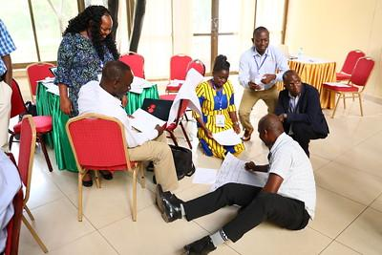
Next step
Proceed to your breakout groups to build your assessment plans
Mzumbe University Course Redesign Workshop, January 2019
CR Slide 3.18

Slide 19
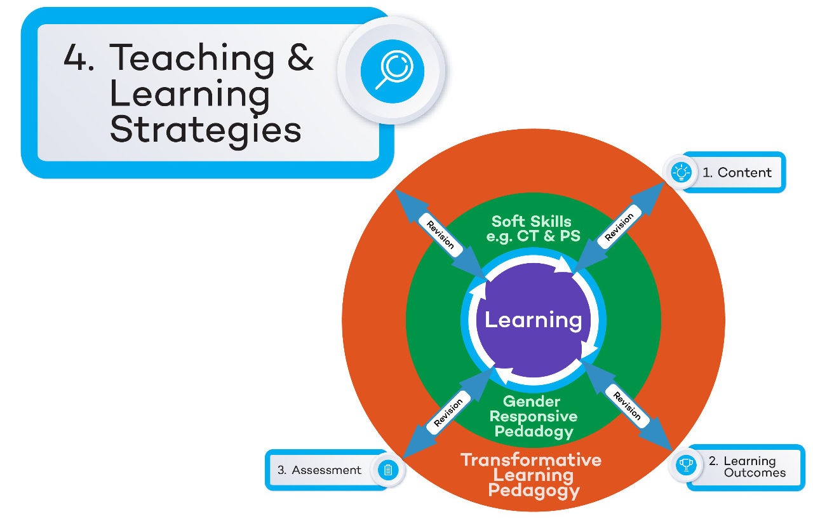
Course Redesign Workshop: Concept Map
CR Slide 3.19

Slide 20
Workshop Content
Content | How do you understand the subject matter and the skills required for your course?
Learning Outcomes | What will students know, value, do as a result of participating in your course?
Assessment | How will you and the students be able to assess progress towards the learning outcomes?
T&L Strategies | What kind of practice and feedback will help students reach the learning outcomes?
Soft Skills | What soft/transferable skills will students have developed as a result of participating in your course?
Gender responsiveness | What gender knowledge and skills will students have developed as a result of participating in your course?
Transformative Learning | How will your course create an environment that promotes critical reflective thinking so that students become the experts they need to be, to transform themselves & their world?
CR Slide 3.20

Slide 21
Three Theories of Teaching
Transmission: Teaching as transmission (focus is on self and one’s expertise)
Transaction: Teaching as knowledge of a large repertoire of teaching strategies (focus is on keeping the students active – active vs. passive learners)
Transformation: Teaching and learning as two sides of the same coin (focus is on supporting the intended student learning)
Ramsden, P. (1992; 2002). Learning to Teach in Higher Education. UK: Routledge
CR Slide 3.21

Slide 22
Constructive Alignment
Learning outcomes Teaching & learning strategies
2. Do students understand what they should be learning from this activity (transparent teaching)?
3. Small changes that can have an impact on students’ learning
CR Slide 3.22

Slide 23
Formative Evaluation
Describe your feelings on Day 3 of the workshop in not more than three words.
CR Slide 3.23

Slide 24








TESCEA was part of the UKAID-funded SPHEIR programme
The SPHEIR (Strategic Partnerships for Higher Education Innovation and Reform) programme supported higher education transformation in focus countries in Sub-Saharan Africa, Asia and the Middle East.
www.spheir.org.uk

