Slide 1


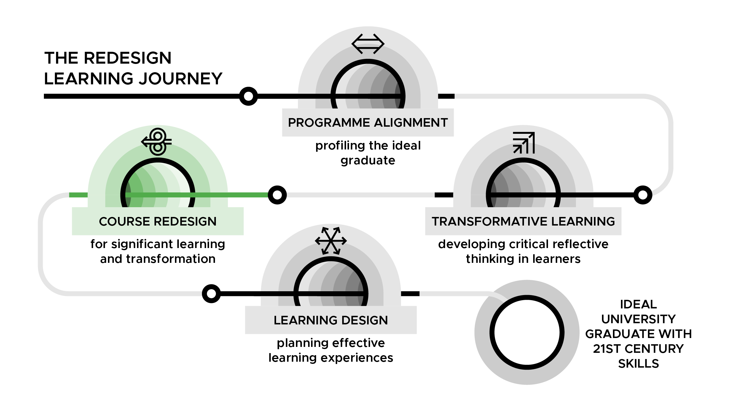

Course Redesign for Significant Learning and Transformation Workshop
DAY 1

Slide 2
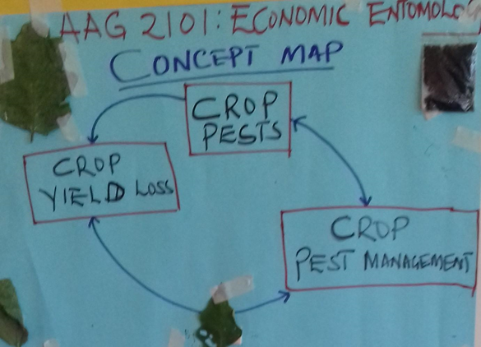
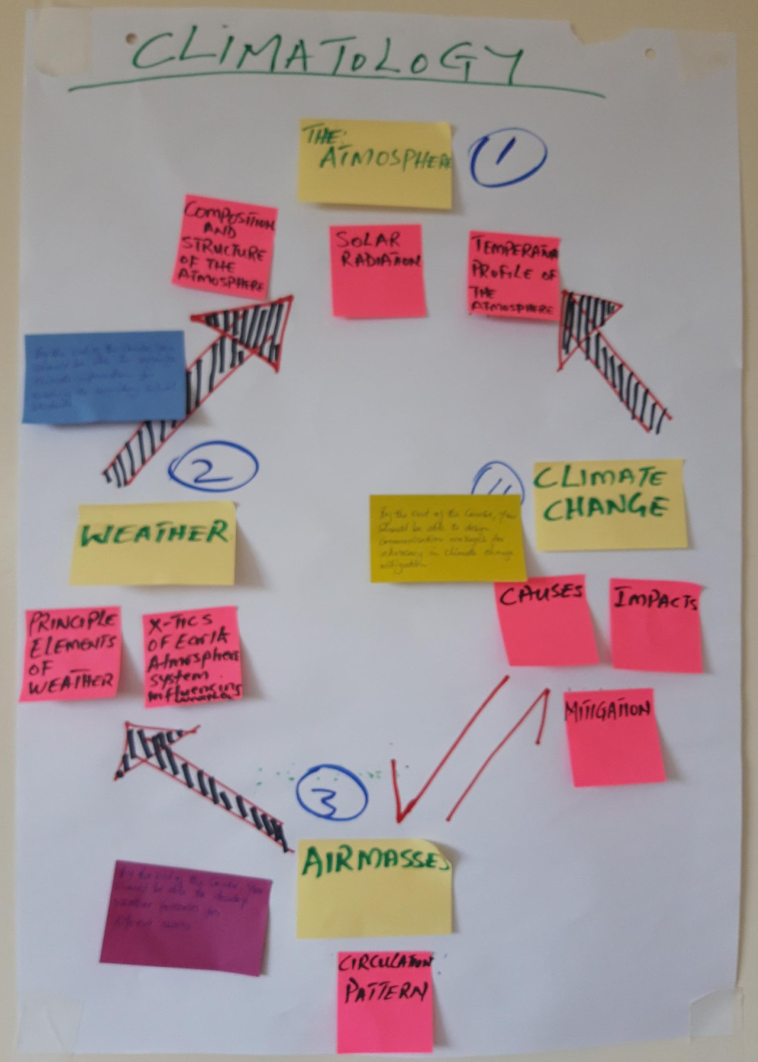
Day 1: Concept Mapping
Climatology course concept map by Expedito Nuwategeka, lecturer at Gulu University
Economics Entomology course concept map by Samuel Kabi, lecturer at Gulu University
CR Slide 1.2

Slide 3
Learning contract - ways of working
CR Slide 1.2
Arrive on time and keep to time
Participate in all sessions: whole group & breakout groups
Ensure that both male and female voices are heard
Cell phones on silent and calls made on breaks
Read all the assigned readings in advance of sessions
Actively listen when others are speaking
Be responsible for your own learning (incl. self-study)
Respect confidentiality
Support the learning of others
CR Slide 1.3
Notes:
Notes

Slide 4
Introduction: workshop facilitators
Note to workshop facilitator: insert the workshop facilitators’ names here:
CR Slide 1.4

Slide 5
Summary from the needs assessment
Note to workshop facilitator: Customise this slide with the results from Q. 2 & 13 in the questionnaire. See the ‘Gathering and/or synthesis of information in advance of workshop’ section in the introductory facilitation guidelines for more detail on preparing the analysis
Q2. Years of university teaching?
Mean: 8.8; Range (1, 25); n=20
Q13. On a scale of 1-10, how would you rate:
Your knowledge of the subject matter in the course you have chosen to redesign?
Mean: 8.3; Range (6,10); n=21
Your knowledge of teaching the course you have chosen to redesign?
Mean: 6.6; Range (2, 9); n=21
Your knowledge of how students learn in the course/discipline?
Mean: 5.7; Range (0, 9); n=21
CR Slide 1.5

Slide 6
Your workshop expectations: Themes
Note to workshop facilitator: input a summary of the responses to Q.15 on expectations from the needs assessment questionnaire.
CR Slide 1.6

Slide 7
Review of Transformative Learning
What symbols, images, words come to mind when you hear the term Transformative Learning?
Write down the words and/or draw the symbols, images, words on large sticky notes or pieces of paper (one contribution per note).
Group the symbols, images and/or words or organise them hierarchically on one piece of flip chart paper.
Draw lines to indicate the relationships between the different words, images, symbols on the concept map.
CR Slide 1.7

Slide 8
Links between Transformative Learning and Course Redesign
How will the course that I am designing, enable my students (both male and female) to live the Big Dream for my course?
What is the most important content (concepts) that my students need to learn in my course so that two, ten years down the line they will still value the course?
What kinds of learning (learning outcomes) do I want my students to experience?
CR Slide 1.8

Slide 9
Prioritising gender
What gender activities have we done in previous workshops?
Why is it important to think about gender and gender responsive pedagogy?
CR Slide 1.9

Slide 10
Gender Dimensions
Gender is…
Representation
Equality/equity
Stereotypes and (conscious/unconscious) bias
Internalised bias
Interaction and space
Power (empowerment)
CR Slide 1.10

Slide 11
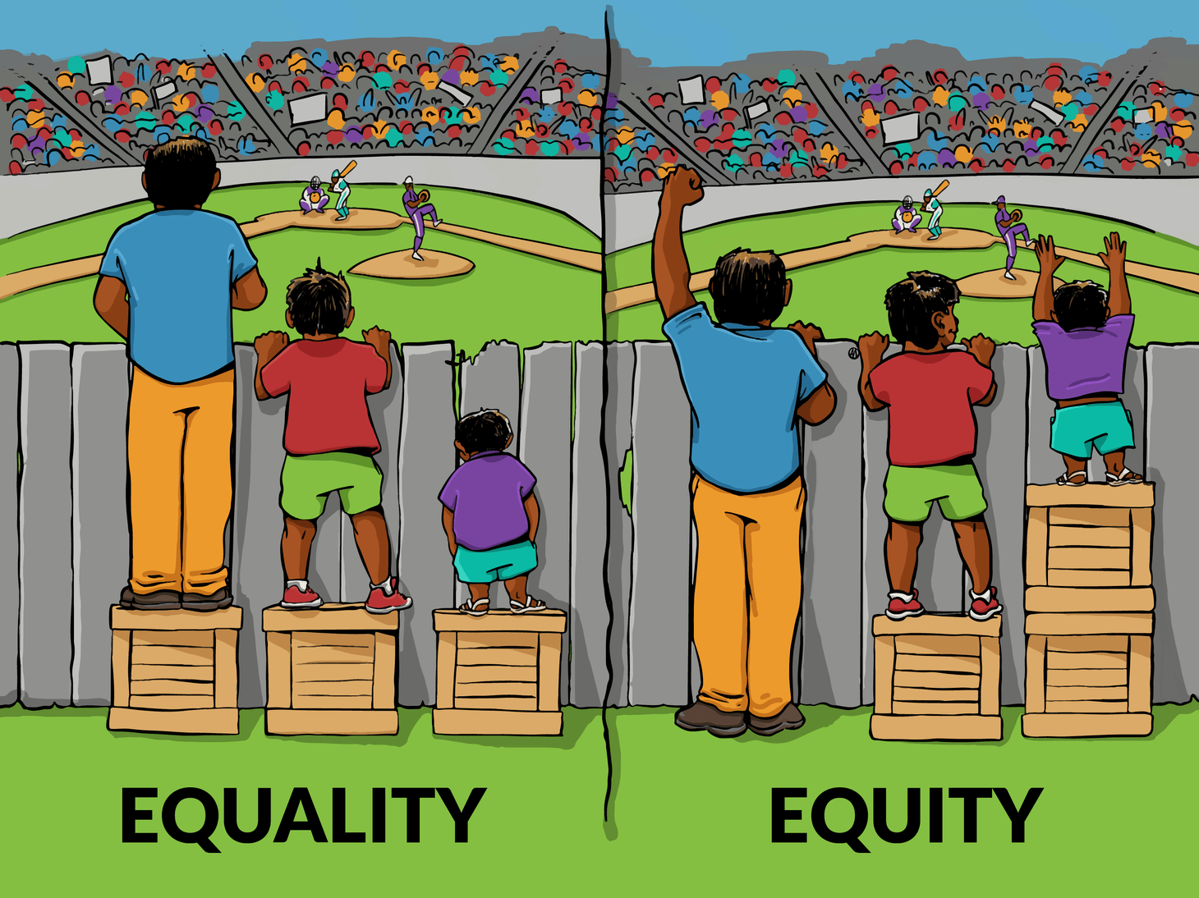
Gender is… equality/equity
Image by “Interaction Institute for Social Change | Artist: Angus Maguire.” https://interactioninstitute.org/illustrating-equality-vs-equity/
CR Slide 1.11

Slide 12
Individual reflection
Think back to your own education (either university or schooling):
Can you think of a time when boys/girls or young men/women were treated differently? Note a couple of points to describe this situation.
What did this teach you about gender/being a man or woman?
As a facilitator of learning now, what would you have done differently in that situation?
CR Slide 1.12

Slide 13
Gender audit of male/female ratios
In programme groups:
What is the ratio of male/female REGISTERED STUDENTS for your programme?
How many LECTURERS in your programme are male/female?
How many VISITING INSTRUCTORS in your course or programme are male/female?
How many of the LEADERSHIP positions in your programme are male/female?
CR Slide 1.13

Slide 14
Gender audit of male/female ratios
[Programme] (gender ratios)
Male/female ratios of REGISTERED STUDENTS:
Male/female ratios of LECTURERS:
Male/female ratios of VISITING INSTRUCTORS:
Male/female ratios of LEADERSHIP:
CR Slide 1.14

Slide 15
Gender audit of male/female ratios
What do these results tell you about your university and the programmes that have been audited?
Do the results align with the aspiration for gender equality at your institution?
CR Slide 1.15

Slide 16
Reading Strategy
Review the text ‘How People Learn’ and select one:
Sentence that captures a core idea of the text
Phrase that engaged, provoked, or surprised you
Word that captured your attention or struck you as being powerful
CR Slide 1.16

Slide 17
Reading Discussion
Now in groups of three, discuss and compare your choices:
What themes emerged?
What did your choices capture?
What implications can we draw?
CR Slide 1.17

Slide 18
In this workshop:
Emphasis will be on your complete course
Your subject matter expertise will serve as a lens to view all aspects of the redesign process
You will discuss and critique outputs with your fellow learners
You will engage in reasoned and transparent decision-making i.e. ’Why do I teach as I do?’
CR Slide 1.18

Slide 19






“We have yet to truly understand that when learning becomes the expressed goal of teaching, that’s a radical realignment with the potential to change every aspect of instructional practice.” Maryellen Weimer (2015)
“What we have and haven’t learned,” Faculty Focus, April 1, 2015
www.facultyfocus.com
CR Slide 1.19

Slide 20
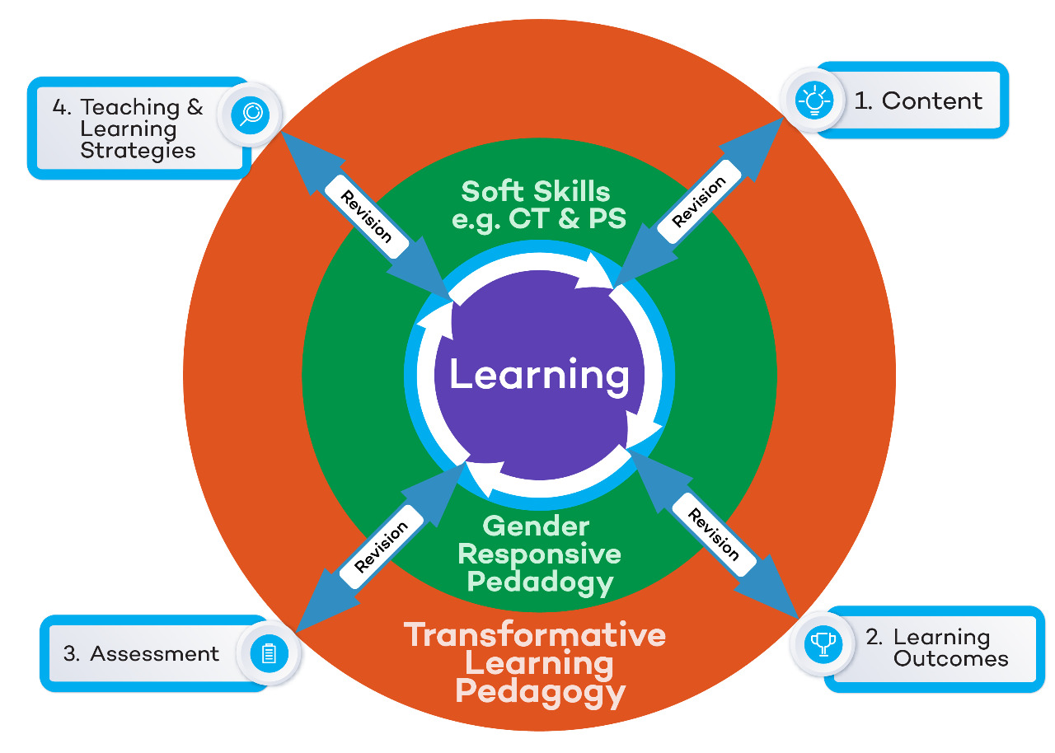
CR Slide 1.20

Slide 21
Content | How do you understand the subject matter and the skills required for your discipline?
Learning Outcomes | What will students know, value, do as a result of participating in your course?
Assessment | How will you and the students be able to assess progress towards the learning outcomes?
T&L Strategies | What kind of practice and feedback will help students reach the learning outcomes?
Soft Skills | What soft/transferable skills will students have developed as a result of participating in your course?
Gender responsiveness | What gender knowledge and skills will students have developed as a result of participating in your course?
Transformative Learning | How will your course create an environment that promotes critical reflective thinking so that students become the experts they need to be, to transform themselves & their world?
Workshop content
CR Slide 1.21

Slide 22

Concept and Topic
1. What is the difference?
2. Between the two which one
is bigger?
CR Slide 1.22

Slide 23
Concept and Topic
Concept
Is a big idea that is timeless, universal and transferable.
For example:
Ecosystem
Prime numbers
Culture
Prejudice
Organism
Topic
Is more about specific times, people, things and places.
For example:
Culture is a concept
The history of the Abaganda and Maji Maji rebellion are topics
CR Slide 1.23

Slide 24
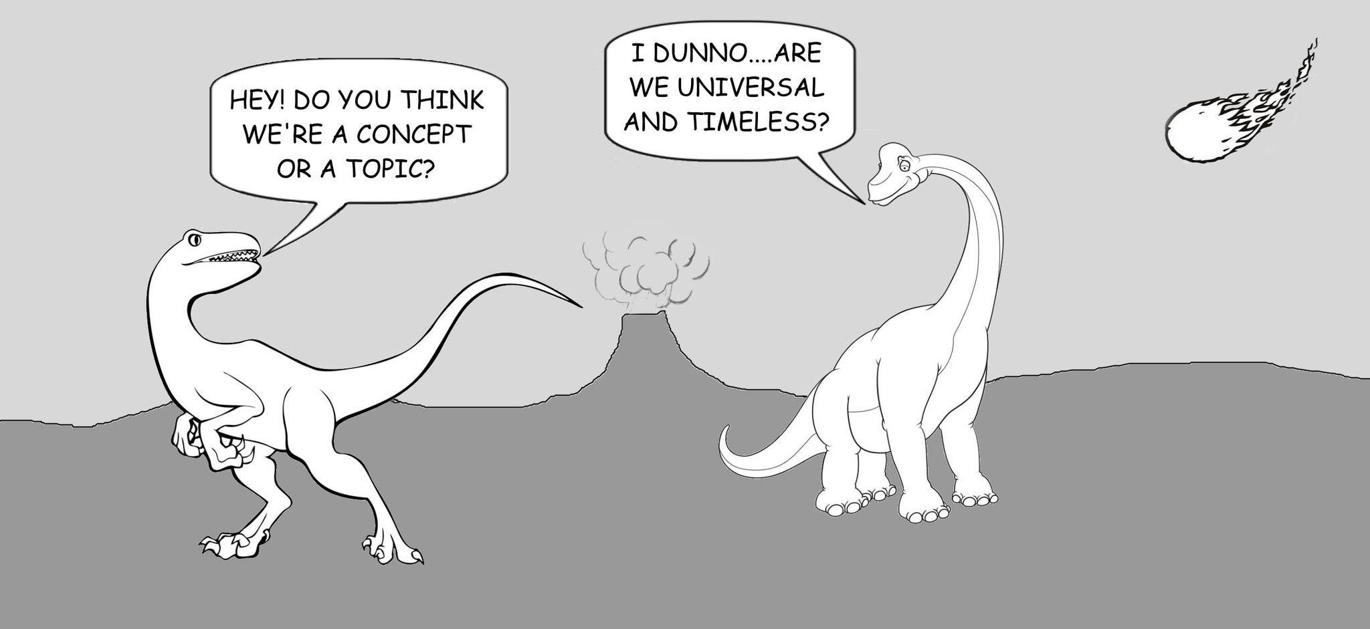
Concept and Topic
CR Slide 1.24

Slide 25

Concept Mapping
Coherent visual representation of the major
concepts in a course and the significant relationships between them.
Based on your understanding of course content.
Conceptual structure of the knowledge in your course that also reflects the purpose of your course that you can share with students and debate with colleagues.
CR Slide 1.25

Slide 26
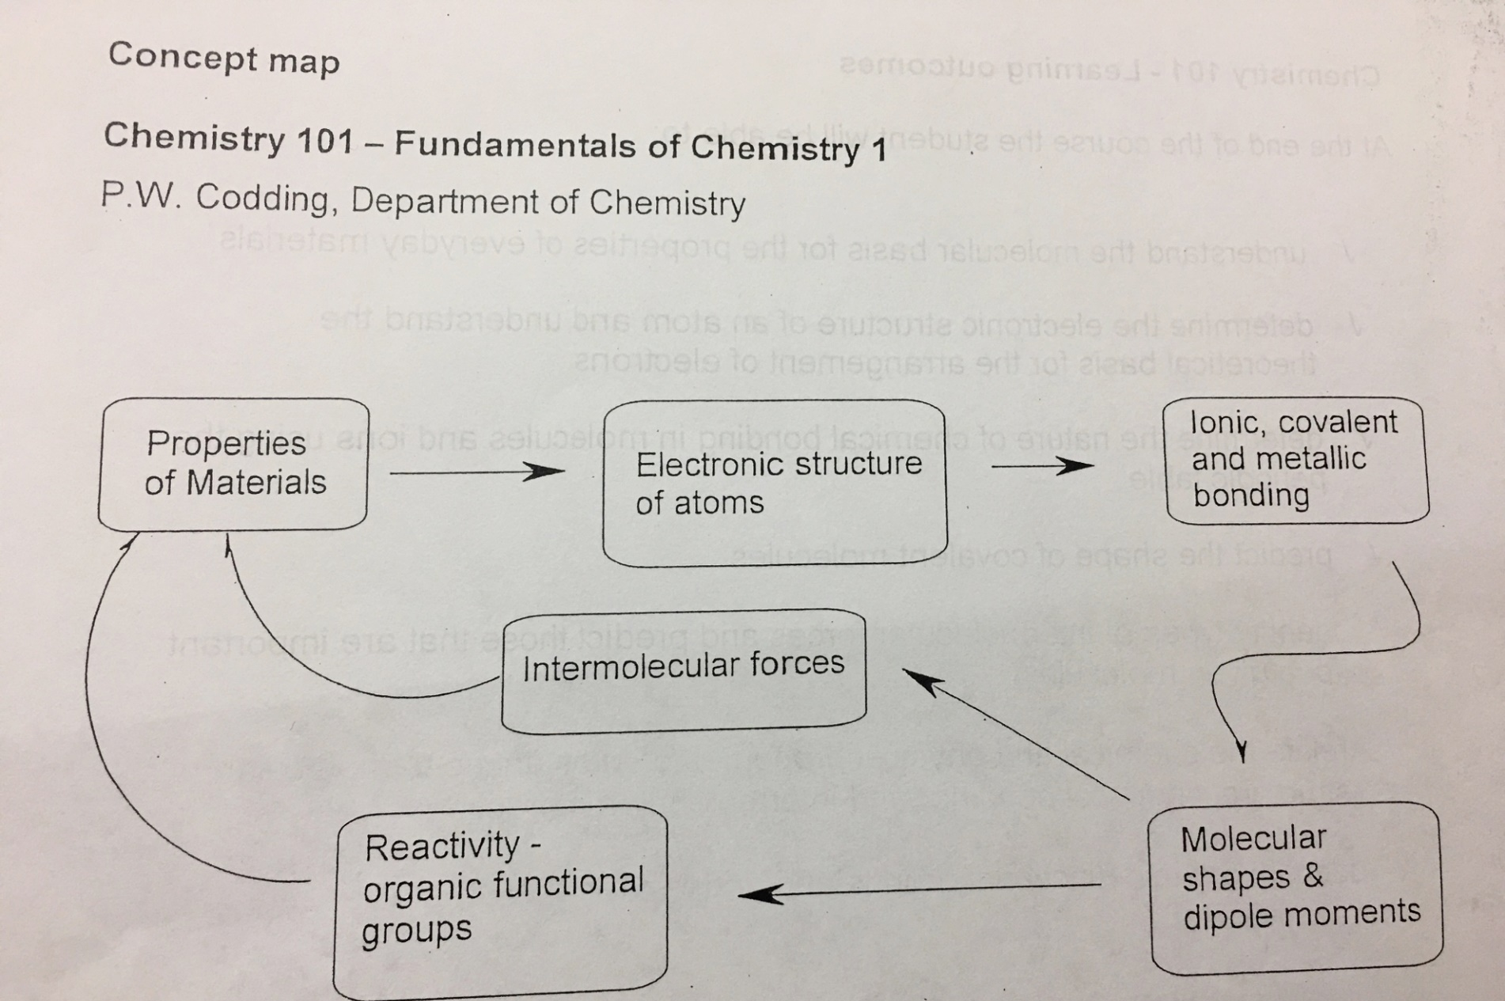
Meaning, Coherence
Source: Prof. Emeritus Geraldine Van Gyn, (UVIC, SFU)
CR Slide 1.26

Slide 27
Quotes on the experience
Made the knowledge structure of the course transparent
Brought parts of the course together
Aided in rethinking course concepts
Adjusted the relative importance of the course concepts
Identified my false assumptions about students learning
Amundsen, C., Weston, C., & McAlpine, L. (2008). Concept Mapping to Support University Academics’ Analysis of Course Content. Studies in Higher Education, 33(6), 633-652.
CR Slide 1.27

Slide 28
Questions to ask yourself when developing a concept map
What is the content of the course?
Can you organise this content into conceptual categories?
Can you identify the relationships between concepts?
CR Slide 1.28

Slide 29
Determining course content
What sources do you refer to when trying to “figure out” what content to include in your course?
Respected textbook(s)
Previous course outlines / materials
Analysis of professional practice
Calendar description
Syllabus
Other?
CR Slide 1.29

Slide 30

Intensive writing exercise
What is, will be, or should be the content or major concepts of the course that you are redesigning?
Image source:
https://www.istockphoto.com/en
CR Slide 1.30

Slide 31
Demonstration: Concept Mapping
Note to workshop facilitator: select one of the following two links for your selected Day 1 video on demonstrating the process of developing a concept map:
Video 1.1a – www.inasp.info/CR11a
Irine Akite of Gulu University, Uganda
Video 1.1b – www.inasp.info/CR11b
Tupokigwe Isagah of Mzumbe University, Tanzania
CR Slide 1.31

Slide 32
Participant allocations to breakout groups and rooms
Group X | Group Y | Group W
Room | Room | Room
Facilitators’ names | Facilitators’ names | Facilitators’ names
List participants’ names below the facilitators’ names
CR Slide 1.32

Slide 33
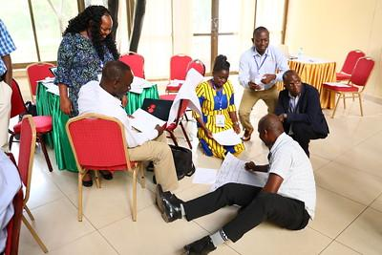
Next step
Proceed to your breakout groups to further develop your course concept maps.
Mzumbe University Course Redesign Workshop, January 2019
CR Slide 1.33

Slide 34
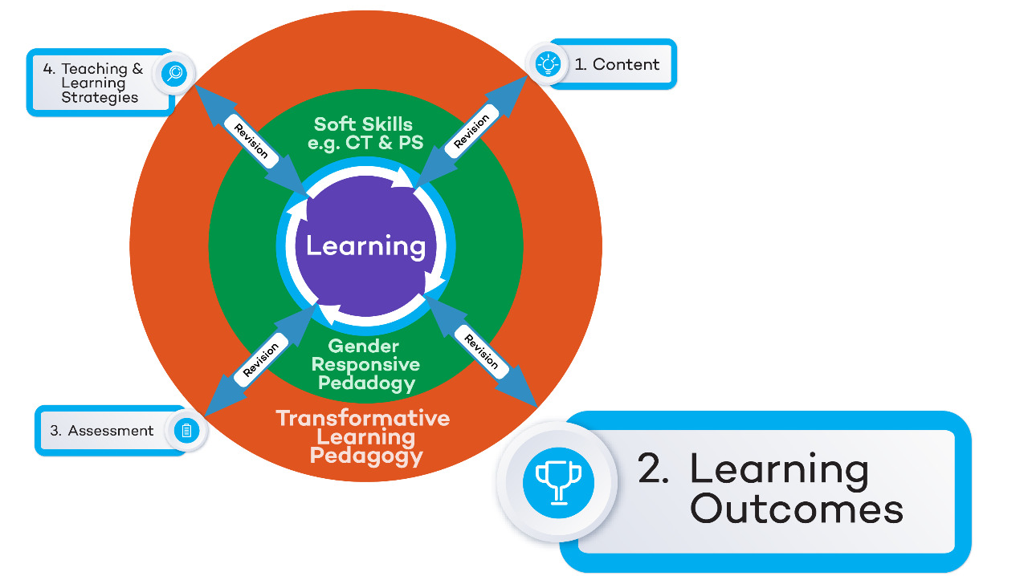
CR Slide 1.34

Slide 35
Workshop Content
Content | How do you understand the subject matter and the skills required for your course?
Learning Outcomes | What will students know, value, do as a result of participating in your course?
Assessment | How will you and the students be able to assess progress towards the learning outcomes?
T&L Strategies | What kind of practice and feedback will help students reach the learning outcomes?
Soft Skills | What soft/transferable skills will students have developed as a result of participating in your course?
Gender responsiveness | What gender knowledge and skills will students have developed as a result of participating in your course?
Transformative Learning | How will your course create an environment that promotes critical reflective thinking so that students become the experts they need to be, to transform themselves & their world?
CR Slide 1.35

Slide 36
Levels of Learning Outcomes
Programme level
Be able to apply quantitative poetic analysis in the study of literature
Course level
Be able to create your own poetry using metrical systems
Class (or learning session) level
Be able to compare and contrast the three types of a poem
CR Slide 1.36

Slide 37
Gender and soft skills in Learning Outcomes
    Gender example:
    Determine the influence of social and cultural gender constructs on the planning, implementation and perception of buildings, cities, landscapes and spaces.¹
    Soft skills example:
    Critically evaluate strategies that minimise the impact of agricultural production on biodiversity.
¹ Example adapted from the General Framework for Incorporating the Gender Perspective in Higher Education Teaching, AQU Catalunya, 2018.
CR Slide 1.37

Slide 38
Writing of Learning Outcomes
One needs to stipulate:
the verb at the appropriate level of understanding (knowledge) or performance (skill) intended;
the topic content the verb is meant to address, the object of the verb in other words;
the context of the content discipline in which the verb is to be deployed.
(Biggs and Tang, 2011)
CR Slide 1.38

Slide 39
Learning Outcomes (verb, content and context)
    Determine the influence of social and cultural gender constructs on the planning, implementation and perception of buildings, cities, landscapes and spaces.
    Critically evaluate strategies that minimise the impact of agricultural production on biodiversity.
CR Slide 1.39

Slide 40
SMART(TT) Learning Outcomes
Specific to the learner: Speak to the learner directly
Measurable: Avoid verbs such as understand, know & comprehend - not easily measurable
Applicable: What’s in it for the learner
Realistic: Doable by the ‘average’ learner
Time bound: Set a deadline
Transparent: Easily understood by the learner
Transferable: State the context
CR Slide 1.40

Slide 41
Examples of Learning Outcomes
1. Analyse the e-marketing environment and provide strategic implications for various environmental factors
Analyse the e-marketing environment for different products and services
Provide strategic implications for various environmental factors
CR Slide 1.41

Slide 42
Examples of Learning Outcomes
Understand different sets of economic problems and their impacts on policy prescription.
Analyse the impact of different economic problems on policy prescription in an economy.
CR Slide 1.42

Slide 43
Examples of SMART(TT) Learning Outcomes
Apply appropriate quality indicators and quality standards to improve the quality of goods and services.
Develop sustainable intervention plans for improving food security in various contexts applying a gender lens.
(Example sourced from Gulu University)
CR Slide 1.43

Slide 44
Formative Evaluation
Summarise what you have learned today and state what you found most useful.
What would you like the facilitation team to do differently tomorrow?
In what ways do you think the facilitation team could be more gender responsive tomorrow?
CR Slide 1.44

Slide 45







TESCEA was part of the UKAID-funded SPHEIR programme
The SPHEIR (Strategic Partnerships for Higher Education Innovation and Reform) programme supported higher education transformation in focus countries in Sub-Saharan Africa, Asia and the Middle East.
www.spheir.org.uk

