Slide 1


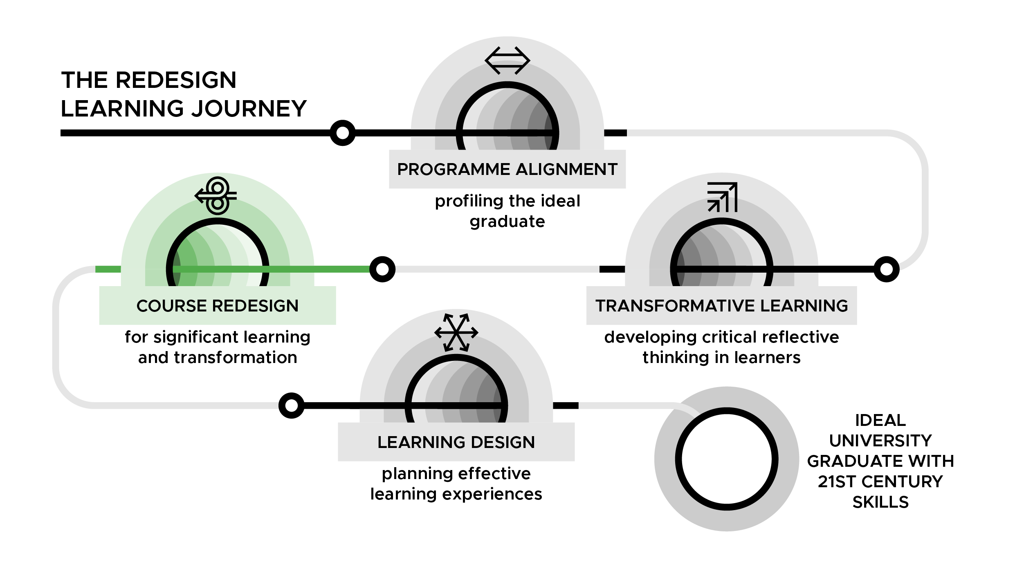

Course Redesign for Significant Learning and Transformation Workshop
DAY 5

Slide 2
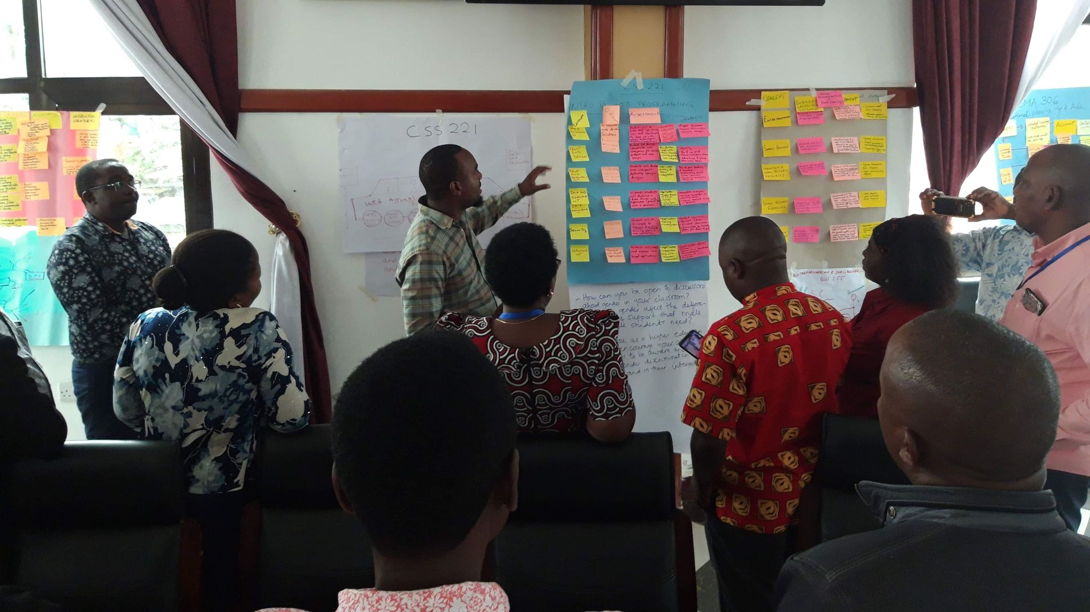
Day 5: Course to learning experience redesign
Mzumbe University Course Redesign Workshop, February 2020
CR Slide 5.2

Slide 3
Formative Evaluation (Day 4)
CR Slide 1.2
What has been the most valuable thing you have learnt so far?
What question do you have, related to one of the concepts in the map, do you need or want to find the answer to?
CR Slide 5.3

Slide 4
Gender is…
Representation
Equality/equity
Stereotypes and (conscious/unconscious) bias
Internalised bias
Interaction and space
Power (empowerment)
CR Slide 5.4

Slide 5
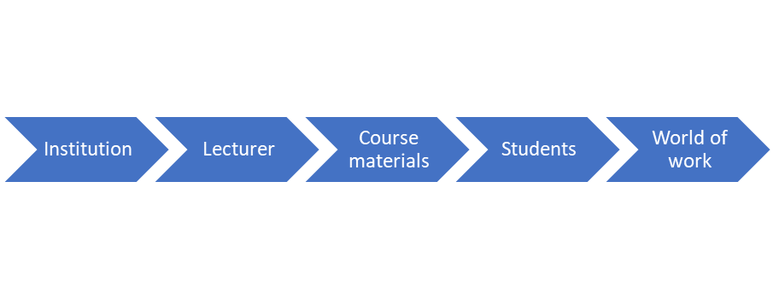
Knowledge and power flows
Where and how does gender play out in this flowchart?
Look at the direction of the arrows: does knowledge/power only flow in this way?
CR Slide 5.5

Slide 6
Individual reflection
What is your key takeaway from the gender sessions?
What are you going to do to make your course more gender responsive going forward?
Who are you going to communicate your learning to, about how to make your course more gender responsive following this workshop?
CR Slide 5.6

Slide 7
Introduction to the Learning Designer tool
Introduction to Learning Designer: www.inasp.info/CR51
Experiences of Learning Designer:
Gloriana Monko, University of Dodoma www.inasp.info/CR52
Docus Alowo, Gulu University www.inasp.info/CR53
CR Slide 5.7

Slide 8
Example Learning Designs
Learning design 1:
Disease Markers - LD (ucl.ac.uk)
Learning design 2:
Neuroanatomy and Development of CNS - LD (ucl.ac.uk)
CR Slide 5.8

Slide 9
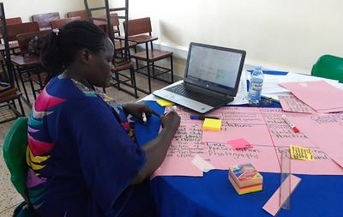
Trying out the Learning Designer Tool
Learning Designer Guide - www.inasp.info/CR54
Gulu University Course Redesign Workshop, August 2019
CR Slide 5.9

Slide 10
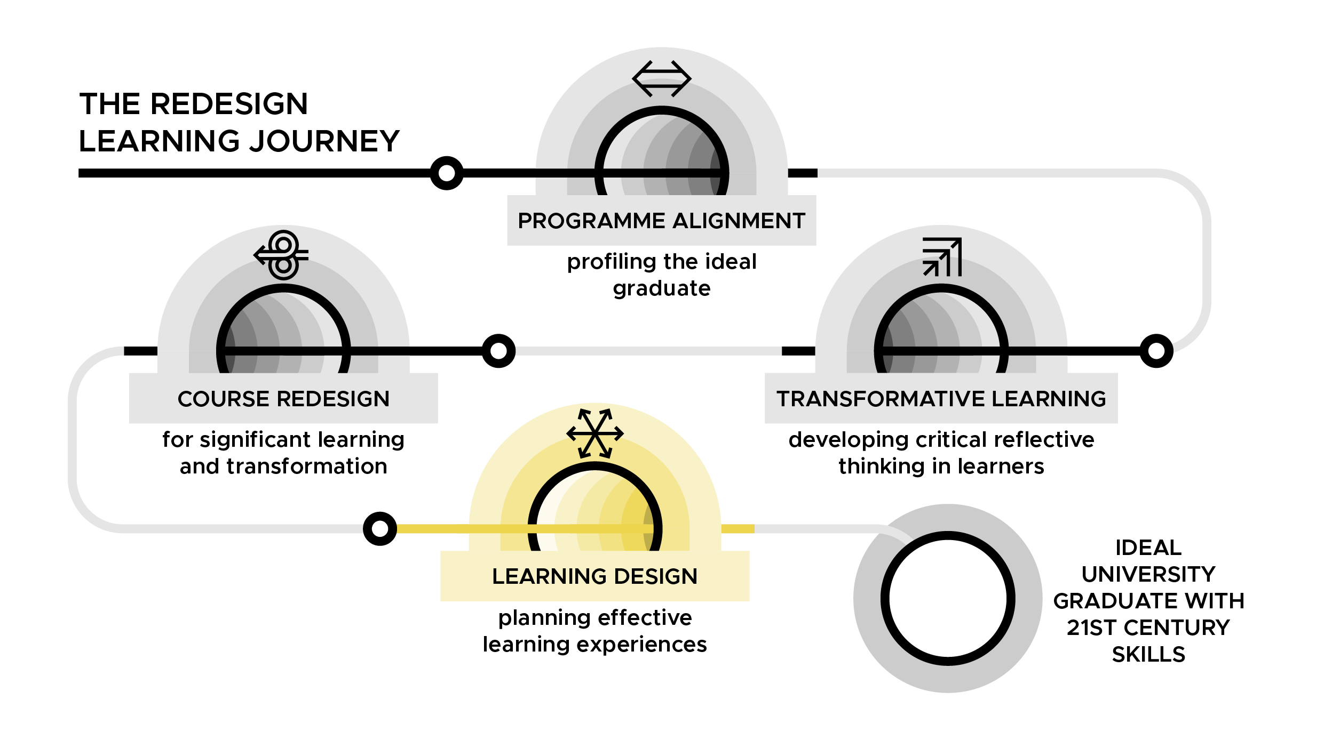
Overview of the ‘Learning Design – planning effective learning experiences’ course
CR Slide 5.10

Slide 11
Workshop Evaluation
Note to workshop facilitator: if you are using the format of an online survey you can insert the link here
CR Slide 5.11

Slide 12








TESCEA was part of the UKAID-funded SPHEIR programme
The SPHEIR (Strategic Partnerships for Higher Education Innovation and Reform) programme supported higher education transformation in focus countries in Sub-Saharan Africa, Asia and the Middle East.
www.spheir.org.uk

